Slide 1



Juliet
Romeo
&
Wedding Album
GALLERIES
VIDEOS
OUR WEDDING
ABOUT US

Slide 2




Juliet
Romeo
&
Wedding Album
Romeo is here
Forever love1
Forever love2
Juliet is here
GALLERIES
VIDEOS
OUR WEDDING
ABOUT US

Slide 3

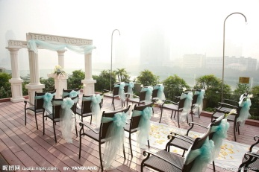
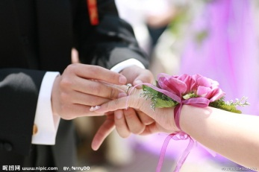
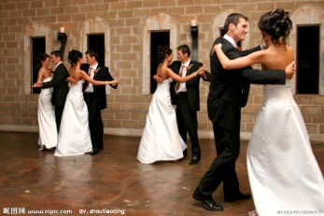
Juliet
Romeo
&
Wedding Album
Romeo is here
Forever love1
Decorate
Waiting
Ring to wear
Dance
Forever love2
Juliet is here
Romantic garden
October 23(rd),1562
GALLERIES
VIDEOS
OUR WEDDING
ABOUT US

Slide 4


Juliet
Romeo
&
Wedding Album
Decorate
Waiting
Ring to wear
Dance
Romeo
Juliet
Romantic garden
October 23(rd),1562
GALLERIES
VIDEOS
OUR WEDDING
ABOUT US

Slide 5
Juliet
Romeo
&
Wedding Album
zzplovezzp
GALLERIES
VIDEOS
OUR WEDDING
ABOUT US

Slide 6

免费PPT模版下载：http://www.lfppt.com/pptmb.aspx
免费PPT特效动画: http://www.lfppt.com/pptmb_14.html
免费PPT工作汇报: http://www.lfppt.com/zchb.aspx
免费PPT创意开场：http://www.lfppt.com/pptmb_21.html
搜索: www.lfppt.com
LFPPT网
免费下载，每天更新
LFPPT网1群 251106778
计划总结PPT/年会颁奖PPT/演讲辩论PPT/毕业答辩PPT/简历竞聘PPT

Slide 7

衷心的感谢您的支持，
您的每一份支持都是我前进的动力！

