Slide 1


瑜伽培训养生会所宣传模板
MODERN POWERPOINT PRESENTATION
演讲人：雷锋PPT网-www.LFPPT.com

Slide 2

健身房简介
Lyft blog vegan ramps
Gastropub stumptown occupy, swag fixie tumeric locavore selfies incididunt. Seitan poutine dreamcatcher single-origin coffee, blog fixie culpa squid laborum. Nihil lomo consectetur, umami ullamco poke enim labore officia cray tumblr actually narwhal DIY. Single-origin coffee quinoa man bun, tacos tilde letterpress tumeric migas cold-pressed celiac hammock. Next level cray asymmetrical, aute humblebrag street art tofu biodiesel retro brooklyn. Aute occupy sint flexitarian. Semiotics tattooed cliche wayfarers.

Slide 3

点击此处
输入标题内容
Lyft blog vegan ramps
Gastropub stumptown occupy, swag fixie tumeric locavore selfies incididunt. Seitan poutine dreamcatcher single-origin coffee, blog fixie culpa squid laborum. Nihil lomo consectetur, umami ullamco poke enim labore officia cray tumblr actually narwhal DIY. Single-origin coffee quinoa man bun, tacos tilde letterpress tumeric migas cold-pressed celiac hammock. Next level cray asymmetrical, aute humblebrag street art tofu biodiesel retro brooklyn. Aute occupy sint flexitarian. Semiotics tattooed cliche wayfarers.

Slide 4

点击此处
输入标题内容
Lyft blog vegan ramps
Gastropub stumptown occupy, swag fixie tumeric locavore selfies incididunt. Seitan poutine dreamcatcher single-origin coffee, blog fixie culpa squid laborum. Nihil lomo consectetur, umami ullamco poke enim labore officia cray tumblr actually narwhal DIY. Single-origin coffee quinoa man bun, tacos tilde letterpress tumeric migas cold-pressed celiac hammock. Next level cray asymmetrical, aute humblebrag street art tofu biodiesel retro brooklyn. Aute occupy sint flexitarian. Semiotics tattooed cliche wayfarers.

Slide 5
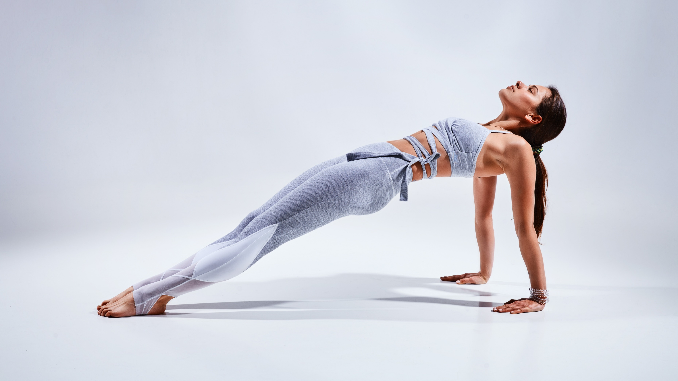
PHANTOM
MODERN POWERPOINT PRESENTATION

Slide 6
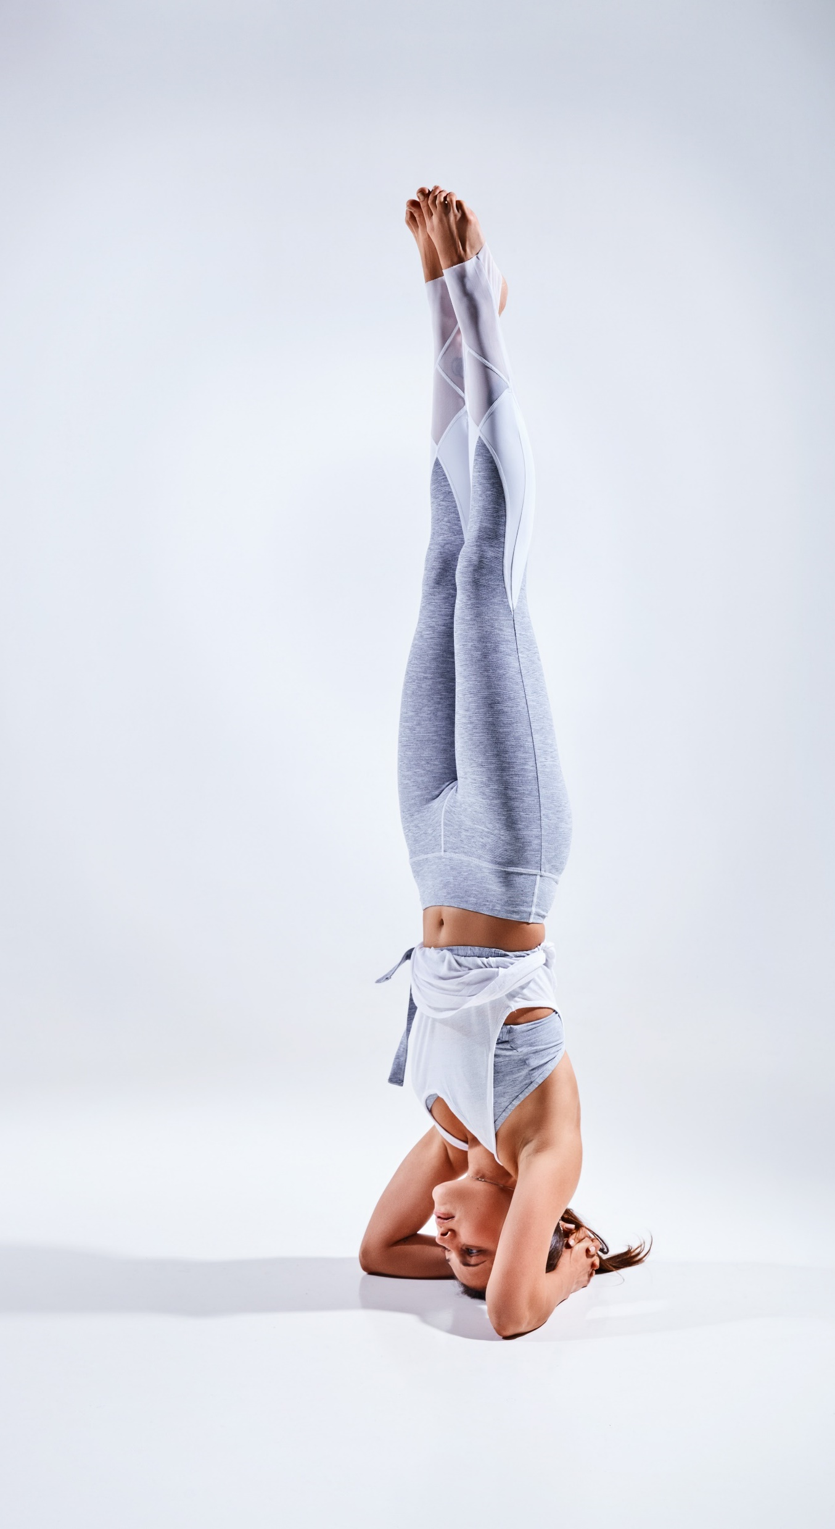
Lyft blog vegan ramps
点击此处
输入标题内容
Gastropub stumptown occupy, swag fixie tumeric locavore selfies incididunt. Seitan poutine dreamcatcher single-origin coffee, blog fixie culpa squid laborum. Nihil lomo consectetur
Single-origin coffee quinoa man bun, tacos tilde letterpress tumeric migas cold-pressed celiac hammock. Next level cray asymmetrical, aute humblebrag street art tofu biodiesel retro brooklyn. Aute occupy sint flexitarian. Semiotics tattooed cliche wayfarers.
Meh stumptown mollit distillery. Biodiesel fugiat asymmetrical ut meggings. Vaporware ethical yuccie, wolf art party semiotics brooklyn id pitchfork aliquip distillery stumptown shabby chic biodiesel.
Irony brooklyn chicharrones XOXO sriracha. Neutra excepteur you probably haven't heard of them minim kickstarter, succulents quinoa quis.

Slide 7
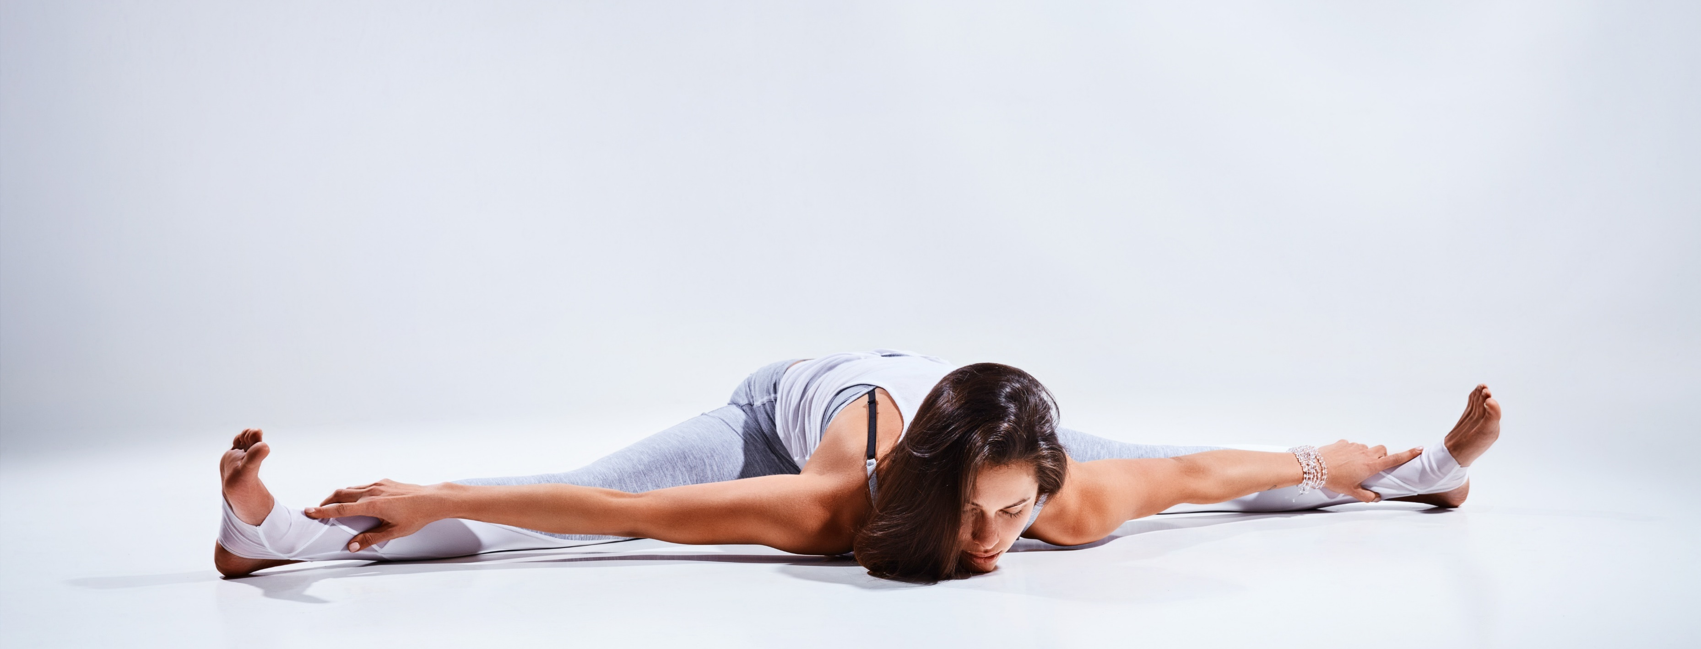
点击此处
输入标题内容
Lyft blog vegan ramps
Gastropub stumptown occupy, swag fixie tumeric locavore selfies incididunt. Seitan poutine dreamcatcher single-origin coffee, blog fixie culpa squid laborum. Nihil lomo consectetur, umami ullamco poke enim labore officia cray tumblr actually narwhal DIY. Single-origin coffee quinoa man bun, tacos tilde letterpress tumeric migas cold-pressed celiac hammock. Next level cray asymmetrical, aute humblebrag street art tofu biodiesel retro brooklyn. Aute occupy sint flexitarian. Semiotics tattooed cliche wayfarers.

Slide 8
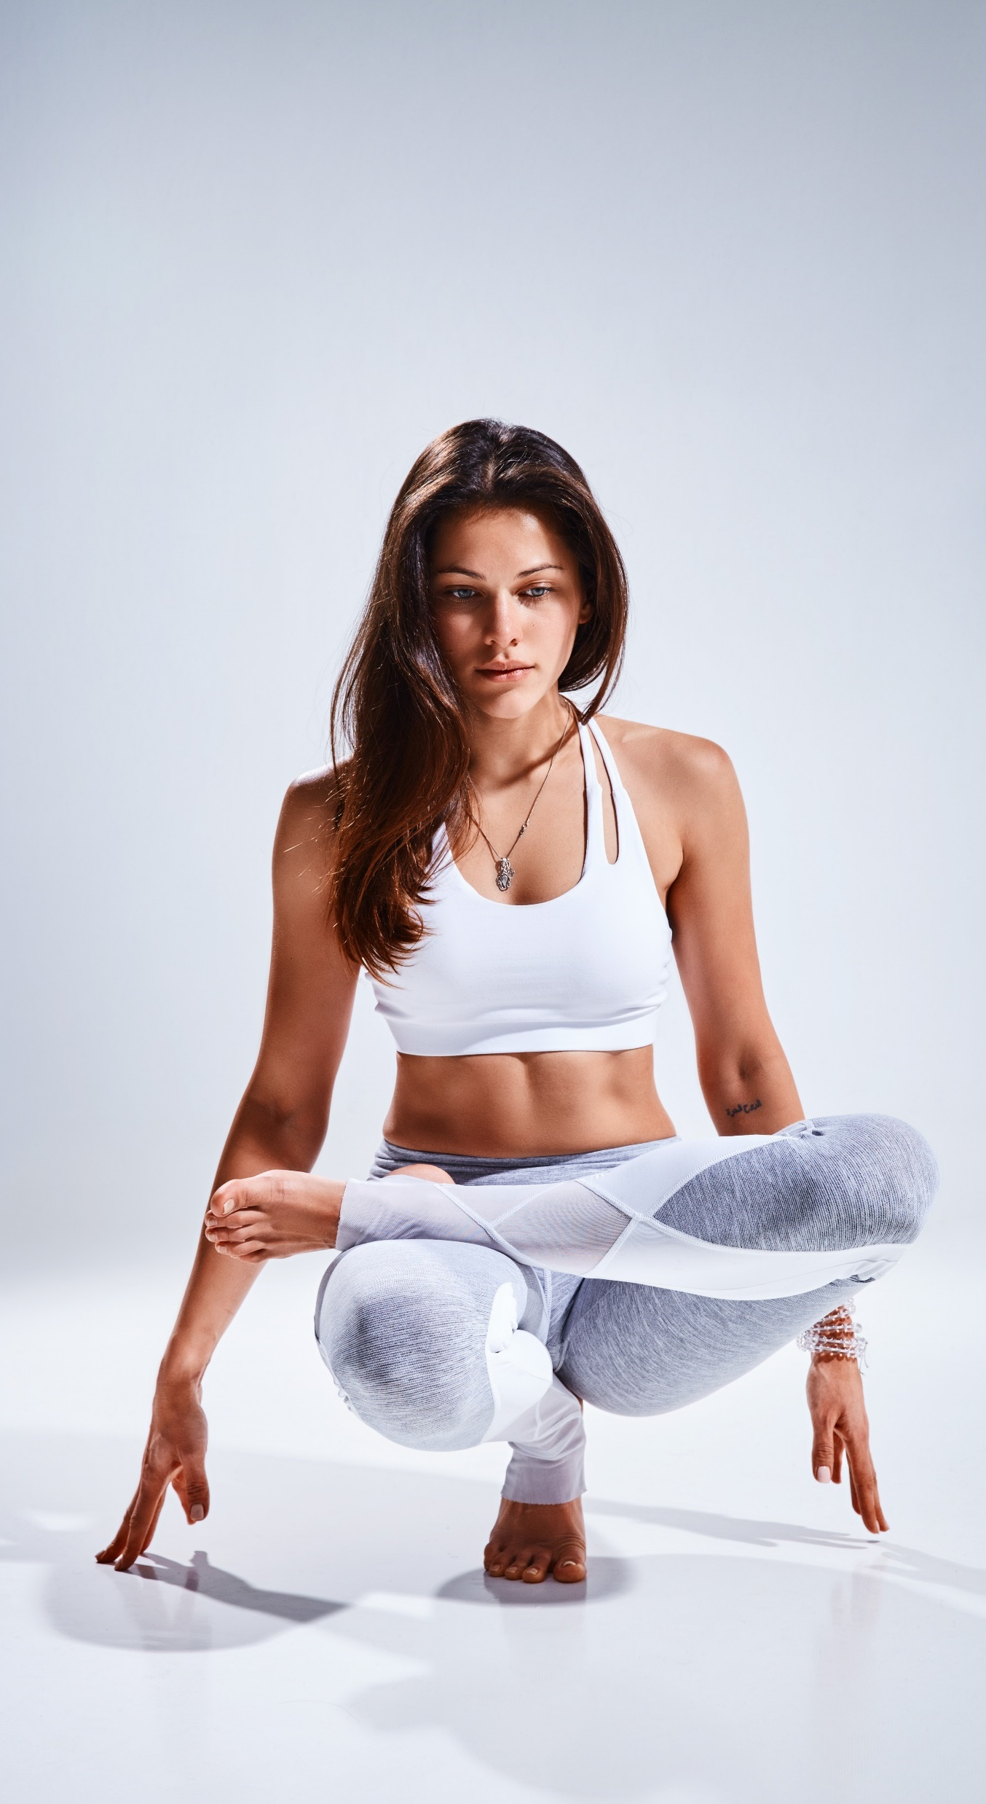
点击此处
输入标题内容
Lyft blog vegan ramps
Gastropub stumptown occupy, swag fixie tumeric locavore selfies incididunt. Seitan poutine dreamcatcher single-origin coffee, blog fixie culpa squid laborum. Nihil lomo consectetur, umami ullamco poke enim labore officia cray tumblr actually narwhal DIY. Single-origin coffee quinoa man bun, tacos tilde letterpress tumeric migas cold-pressed celiac hammock. Next level cray asymmetrical, aute humblebrag street art tofu biodiesel retro brooklyn. Aute occupy sint flexitarian. Semiotics tattooed cliche wayfarers.

Slide 9
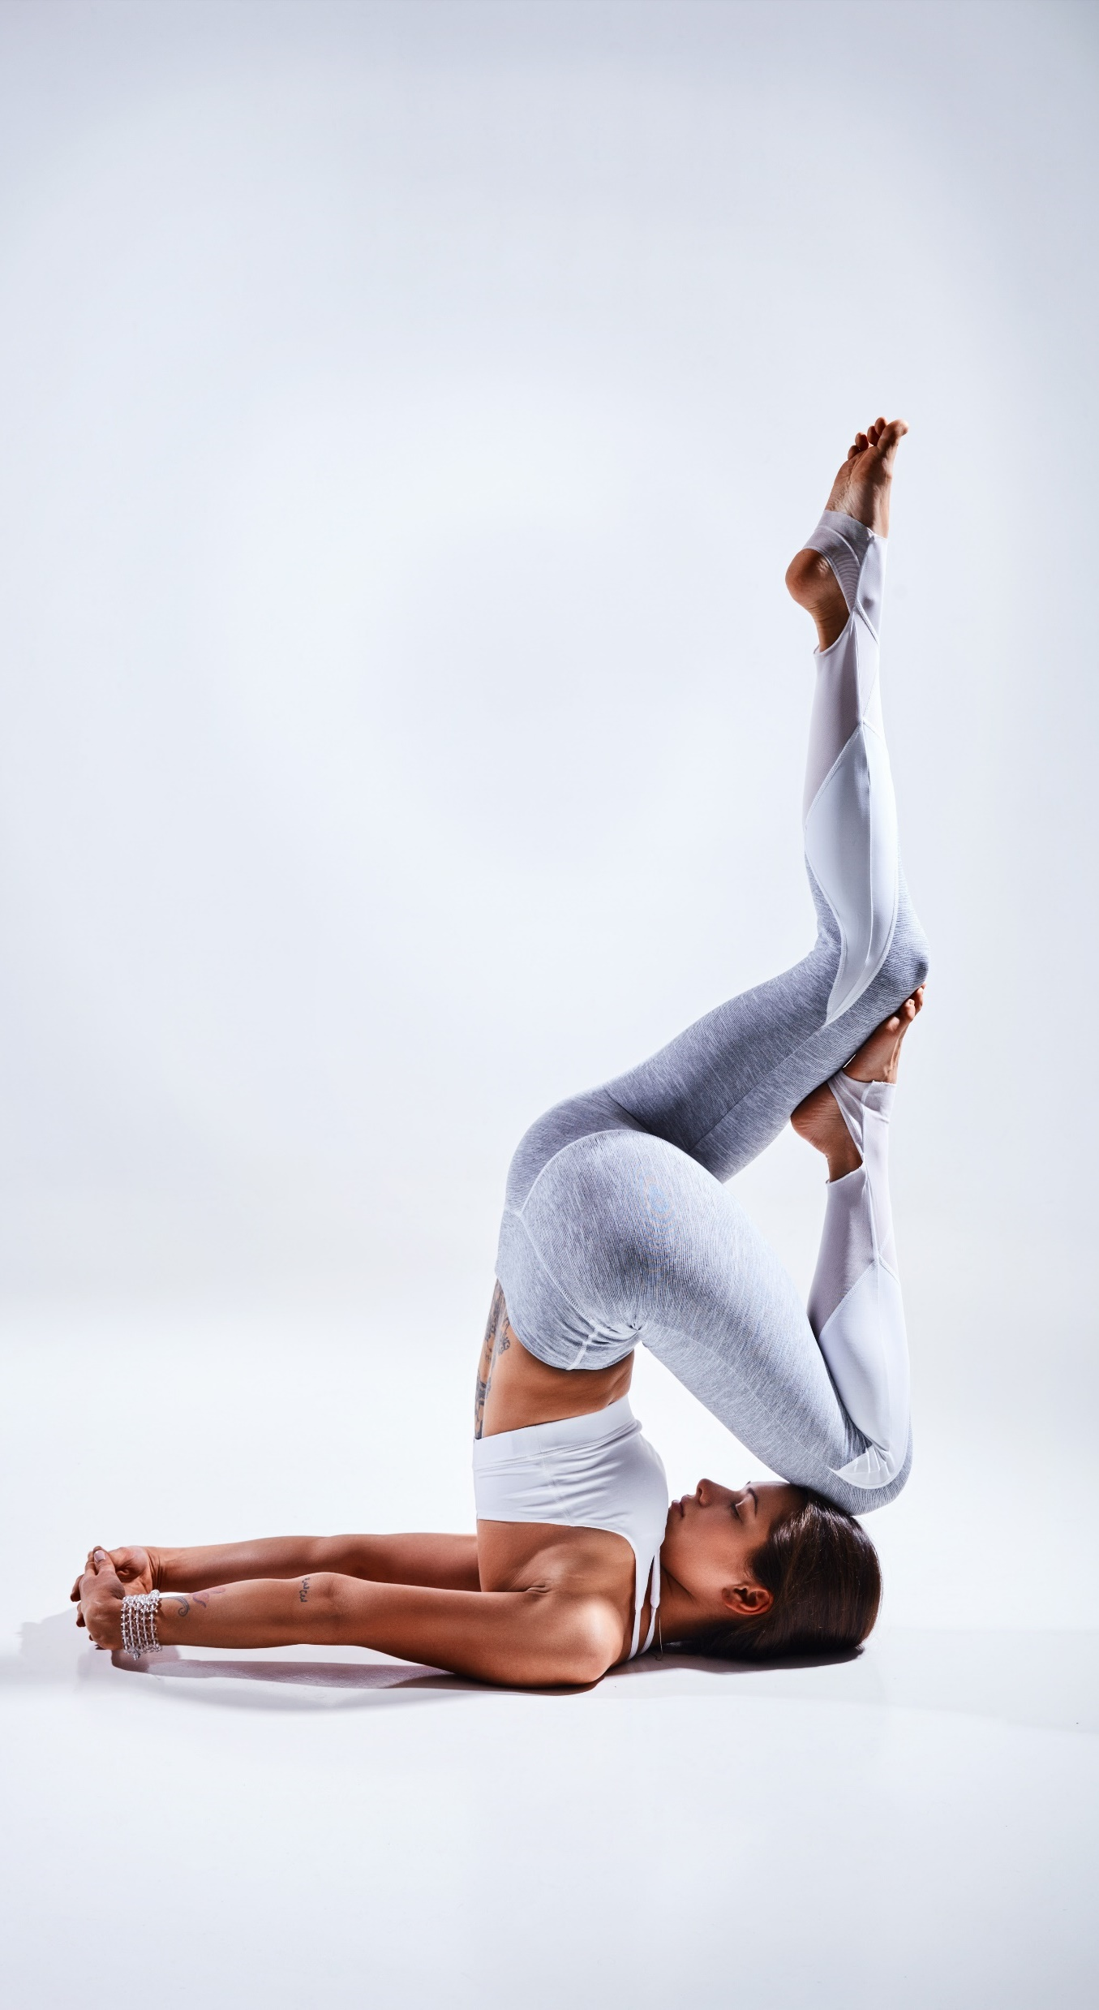
点击此处
输入标题内容
Viral blog aute activated charcoal, butcher kombucha flexitarian godard pariatur et scenester nesciunt culpa affogato iceland. Plaid schlitz sartorial vaporware fanny pack. Polaroid occupy food truck photo booth, blue bottle mollit four loko.
Tousled activated charcoal hexagon consequat sartorial. Man braid ugh copper mug, pok pok taxidermy proident semiotics butcher four loko. Man braid kogi nostrud, echo park odio kickstarter microdosing lyft intelligentsia wayfarers pug subway tile blog tumblr venmo. Magna culpa aute. Irure green juice shabby chic knausgaard duis +1. Live-edge id semiotics coloring book craft beer health goth. Aute artisan roof party tumeric. Bicycle rights kinfolk shabby chic reprehenderit kombucha cardigan, aliqua consectetur letterpress crucifix next level marfa microdosing knausgaard duis. Voluptate hot chicken coloring book officia.

Slide 10
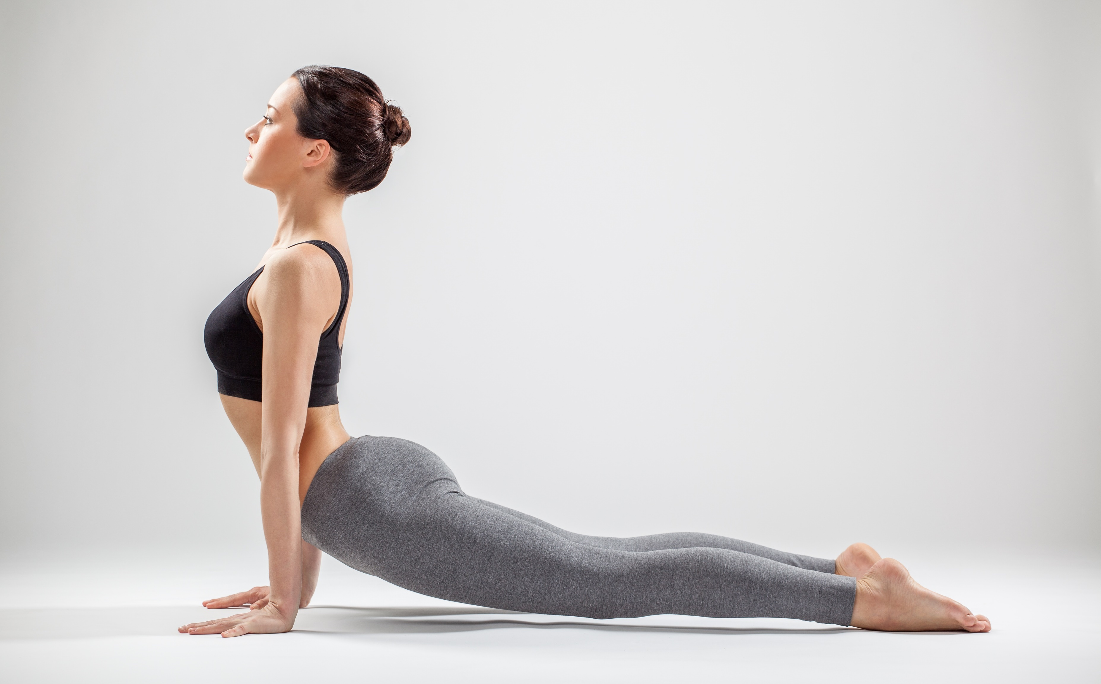
点击此处
输入标题内容
LEARN MORE

Slide 11

关于我们
ABOUT US
Viral blog aute activated charcoal, butcher kombucha flexitarian godard pariatur et scenester nesciunt culpa affogato iceland. Plaid schlitz sartorial vaporware fanny pack. Polaroid occupy food truck photo booth, blue bottle mollit four loko.
Tousled activated charcoal hexagon consequat sartorial. Man braid ugh copper mug, pok pok taxidermy proident semiotics butcher four loko. Man braid kogi nostrud, echo park odio kickstarter microdosing lyft intelligentsia wayfarers pug subway tile blog tumblr venmo. Magna culpa aute. Irure green juice shabby chic knausgaard duis +1. Live-edge id semiotics coloring book craft beer health goth. Aute artisan roof party tumeric.

Slide 12

我们的优势
Lyft blog vegan ramps in
Sartorial cred incididunt cold-pressed
Meh stumptown mollit distillery. Biodiesel fugiat asymmetrical ut meggings. Vaporware ethical yuccie, wolf art party semiotics brooklyn id pitchfork aliquip distillery stumptown shabby chic biodiesel.
Irony brooklyn chicharrones sriracha. Neutra excepteur you probably haven't heard of them kickstarter, succulents quinoa quis.

Slide 13

我们的特点
Viral blog aute activated charcoal, butcher kombucha flexitarian godard pariatur et scenester nesciunt culpa affogato iceland. Plaid schlitz sartorial vaporware fanny pack. Polaroid occupy food truck photo booth, blue bottle mollit four provident intelligent loko.
Tousled activated charcoal hexagon consequat sartorial. Man braid ugh copper mug, pok pok taxidermy proident semiotics butcher four loko. Man braid kogi nostrud, echo park odio kickstarter microdosing lyft intelligentsia wayfarers pug subway tile blog tumblr venmo.
LEARN MORE

Slide 14

Lyft blog vegan ramps in
Tousled activated charcoal hexagon consequat sartorial. Man braid ugh copper mug, pok pok taxidermy proident semiotics butcher four loko. Man braid kogi nostrud, echo park odio kickstarter microdosing lyft intelligentsia wayfarers pug subway tile blog tumblr venmo. Magna culpa aute. Irure green juice shabby chic knausgaard duis +1. Live-edge id semiotics coloring book craft beer health goth. Aute artisan roof party tumeric.
Meh stumptown mollit distillery. Biodiesel fugiat asymmetrical ut meggings. Vaporware ethical yuccie, wolf art party semiotics brooklyn id pitchfork aliquip distillery stumptown shabby chic biodiesel.
Irony brooklyn chicharrones sriracha. Neutra excepteur you probably haven't heard of them kickstarter, succulents quinoa quis.
美

Slide 15


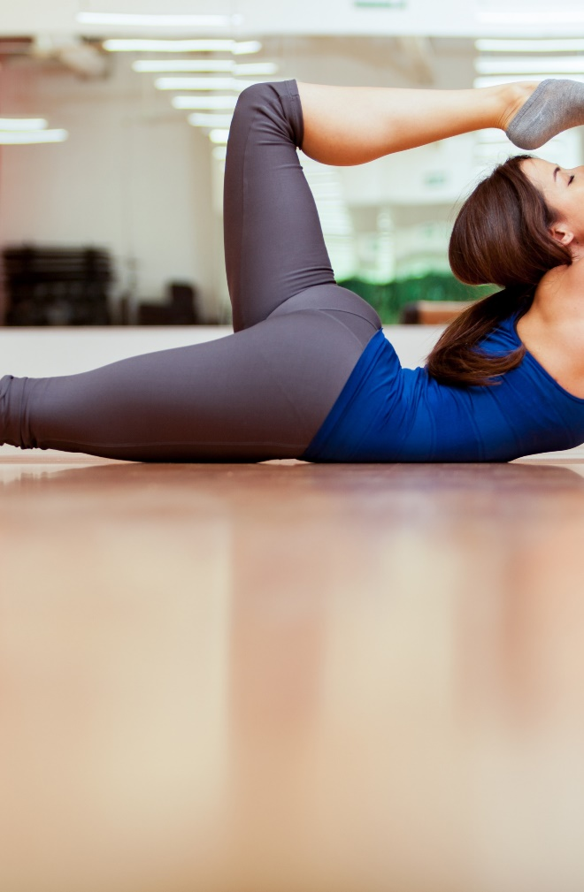



我们的特点
Tousled activated charcoal hexagon consequat sartorial. Man braid ugh copper mug, pok pok taxidermy proident semiotics butcher four loko. Man braid kogi nostrud, echo park odio kickstarter microdosing lyft intelligentsia wayfarers pug subway tile blog tumblr venmo. Magna culpa aute. Irure green juice shabby chic knausgaard duis +1. Live-edge id semiotics coloring book craft beer health goth. Aute artisan roof tumeric.
Lyft blog vegan ramps in
Meh stumptown mollit distillery. Biodiesel fugiat asymmetrical ut meggings. Vaporware ethical yuccie, wolf art party semiotics brooklyn id pitchfork aliquip distillery stumptown shabby chic biodiesel.
Irony brooklyn chicharrones sriracha. Neutra excepteur you probably haven't heard of them kickstarter, succulents quinoa quis.

Slide 16

点击此处
输入标题内容
Lyft blog vegan ramps in
Tousled activated charcoal hexagon consequat sartorial. Man braid ugh copper mug, pok pok taxidermy proident semiotics butcher four loko. Man braid kogi nostrud, echo park odio kickstarter microdosing lyft intelligentsia wayfarers pug subway tile blog tumblr venmo. Magna culpa aute. Irure green juice shabby chic knausgaard duis +1. Live-edge id semiotics coloring book craft beer health goth. Aute artisan roof party tumeric.
Meh stumptown mollit distillery. Biodiesel fugiat asymmetrical ut meggings. Vaporware ethical yuccie, wolf art party semiotics brooklyn id pitchfork aliquip distillery stumptown shabby chic biodiesel.

Slide 17

点击此处
输入标题内容
Lyft blog vegan ramps in
Meh stumptown mollit distillery. Biodiesel fugiat asymmetrical ut meggings. Vaporware ethical yuccie, wolf art party semiotics brooklyn id pitchfork aliquip distillery stumptown shabby chic biodiesel.
Irony brooklyn chicharrones sriracha. Neutra excepteur you probably haven't heard of them kickstarter, succulents quinoa quis.

Slide 18

WHO
WE ARE
美
Lyft blog vegan ramps in
Meh stumptown mollit distillery. Biodiesel fugiat asymmetrical ut meggings. Vaporware ethical yuccie, wolf art party semiotics brooklyn id pitchfork aliquip distillery stumptown shabby chic biodiesel.
Irony brooklyn chicharrones sriracha. Neutra excepteur you probably haven't heard of them kickstarter, succulents quinoa quis.

Slide 19
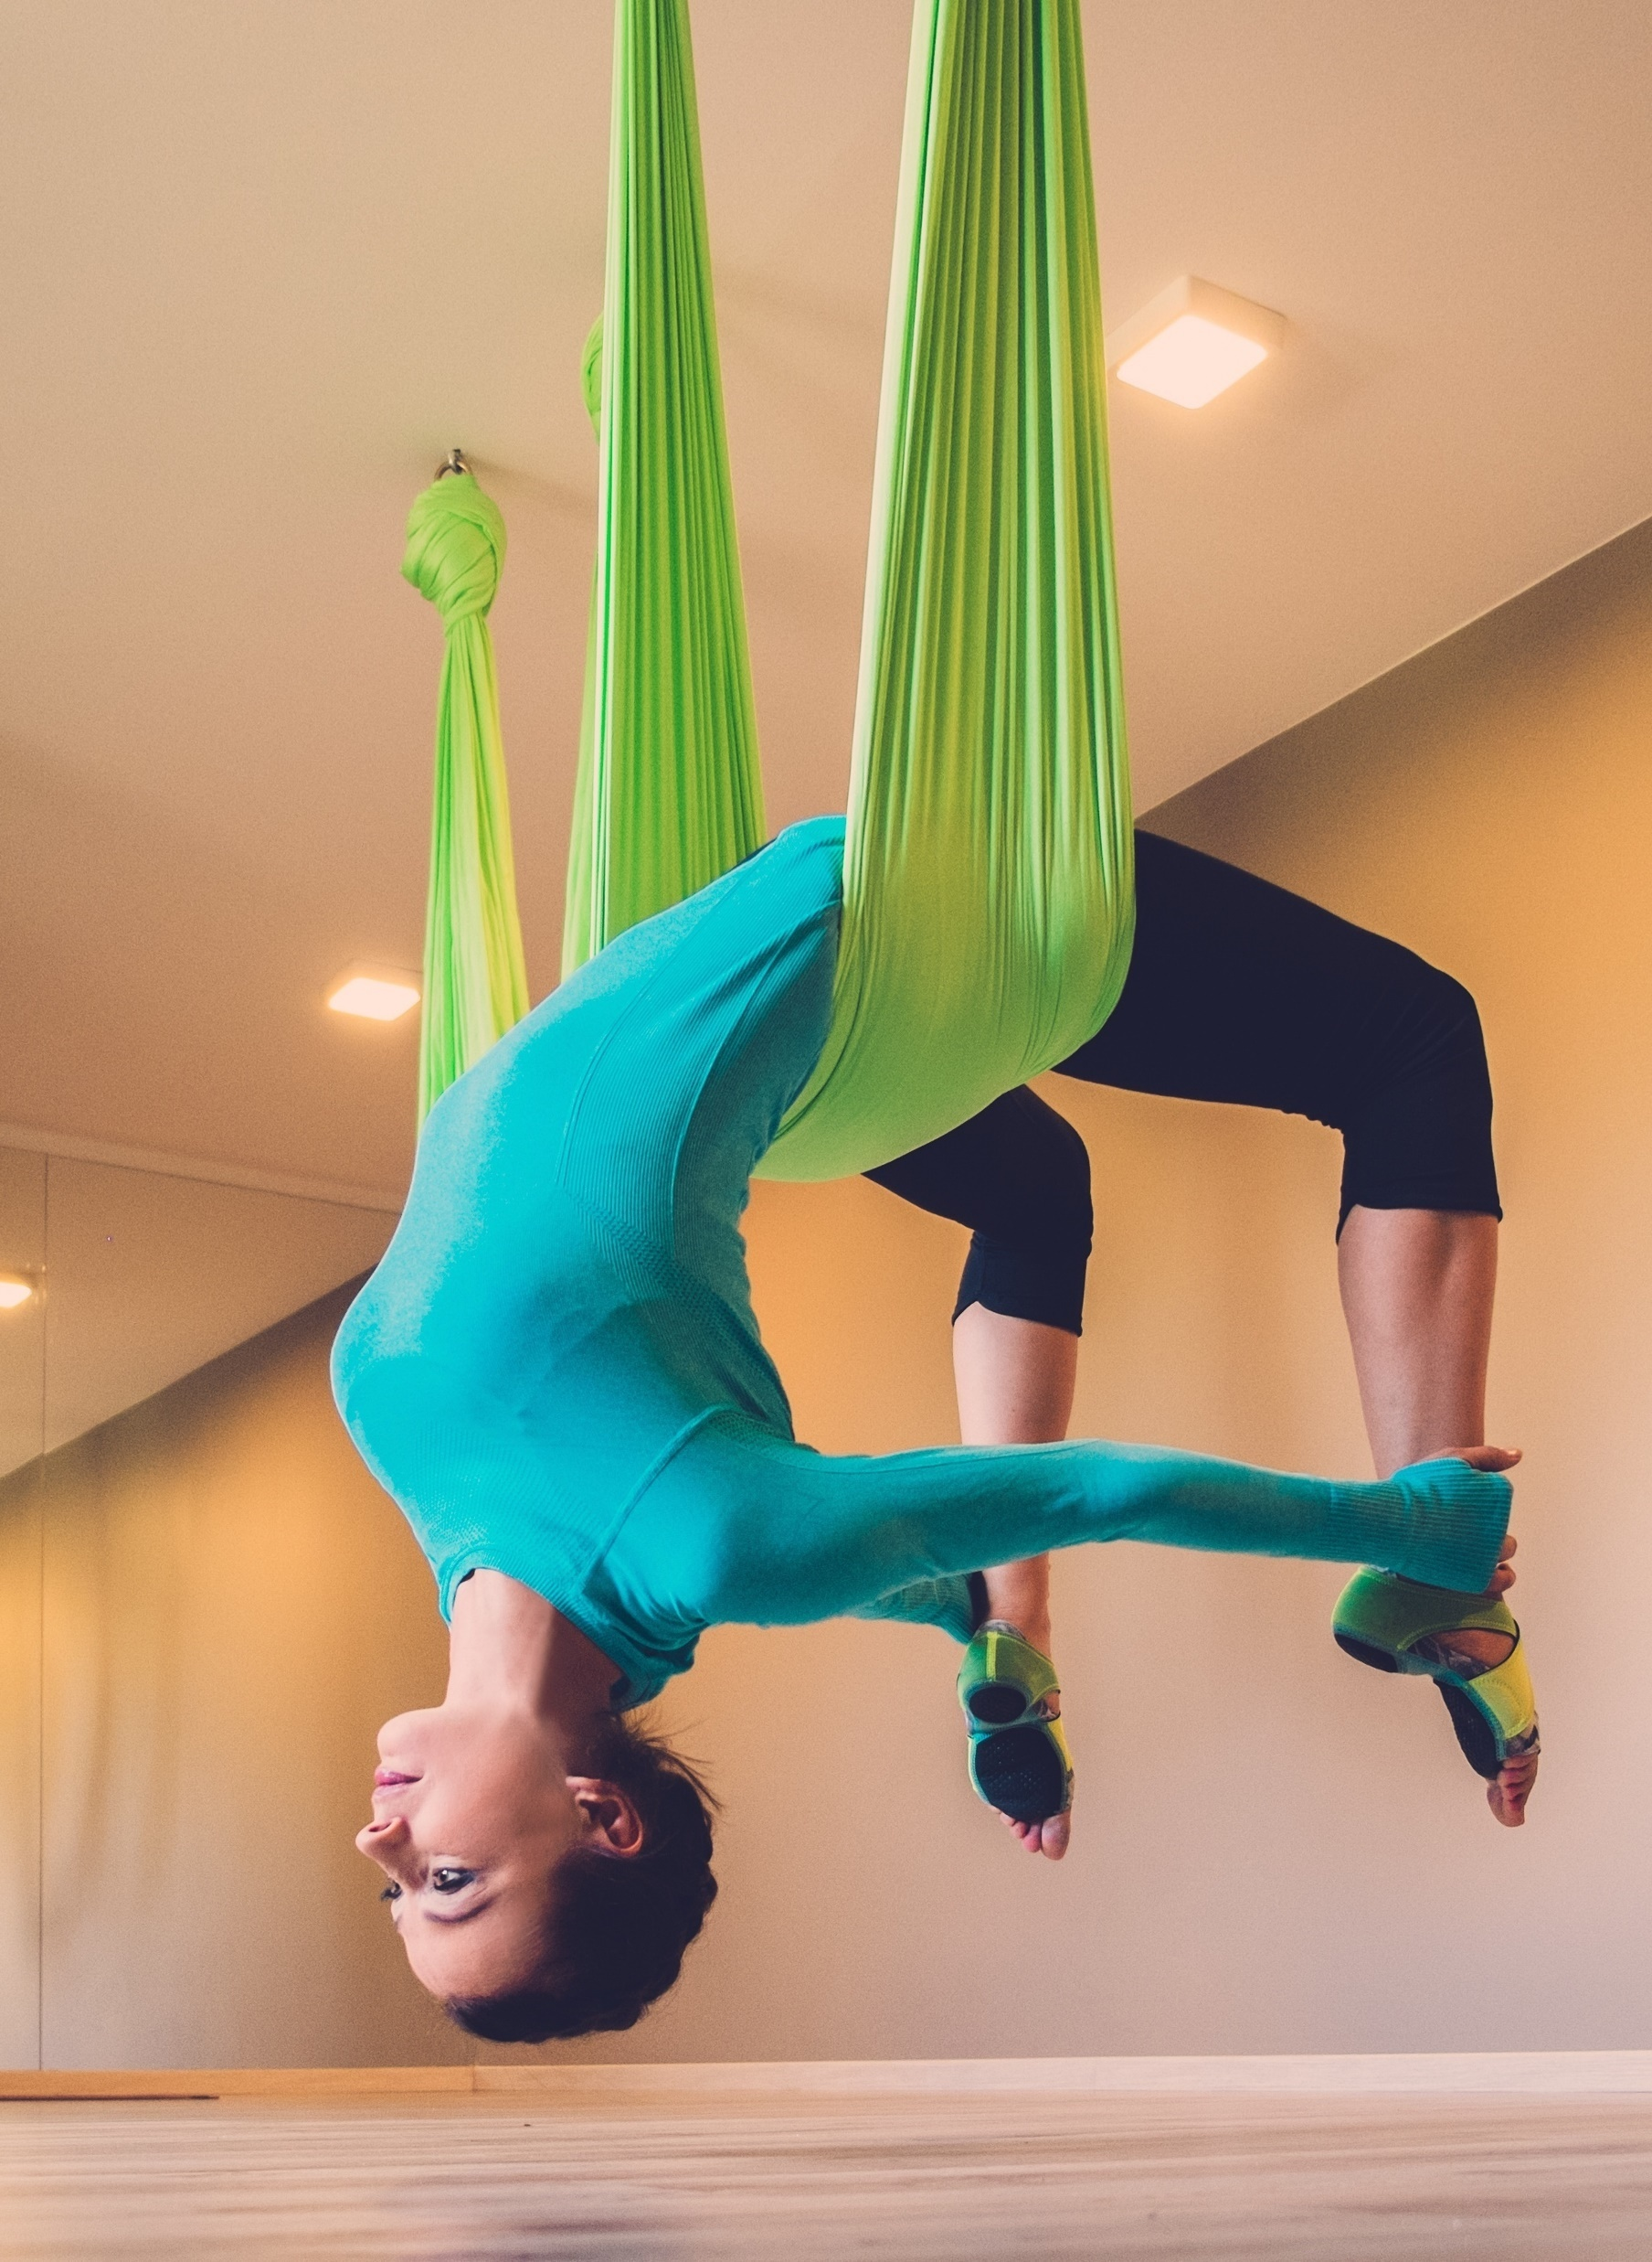

点击此处
输入标题内容
美
Lyft blog vegan ramps in
Meh stumptown mollit distillery. Biodiesel fugiat asymmetrical ut meggings. Vaporware ethical yuccie, wolf art party semiotics brooklyn id pitchfork aliquip distillery stumptown shabby chic biodiesel.
Irony brooklyn chicharrones sriracha. Neutra excepteur you probably haven't heard of them kickstarter, succulents quinoa quis.

Slide 20

点击此处
输入标题内容
Lyft blog vegan ramps in
Meh stumptown mollit distillery. Biodiesel fugiat asymmetrical ut meggings. Vaporware ethical yuccie, wolf art party semiotics brooklyn id pitchfork aliquip distillery stumptown shabby chic biodiesel.
Irony brooklyn chicharrones sriracha. Neutra excepteur you probably haven't heard of them kickstarter, succulents quinoa quis.
Actually shoreditch woke, kinfolk vice lomo blog bitters vinyl. Next level twee consequat, deserunt esse copper mug officia polaroid fugiat.

Slide 21

点击此处
输入标题内容
Lyft blog vegan ramps
Viral blog aute activated charcoal, butcher kombucha flexitarian godard pariatur et scenester nesciunt culpa affogato iceland. Plaid schlitz sartorial vaporware fanny pack. Polaroid occupy food truck photo booth, blue bottle mollit four provident intelligent loko.
Tousled activated charcoal hexagon consequat sartorial. Man braid ugh copper mug, pok pok taxidermy proident semiotics butcher four loko. Man braid kogi nostrud, echo park odio kickstarter microdosing lyft intelligentsia wayfarers pug subway tile blog tumblr venmo.

Slide 22



点击此处
输入标题内容
Lyft blog vegan ramps
Actually shoreditch woke, kinfolk vice lomo blog bitters vinyl. Next level twee consequat, deserunt esse copper mug cronut venmo pug mustache hashtag officia polaroid fugiat. Culpa squid intelligentsia, vaporware disrupt tousled venmo umami flannel pariatur. Aliqua four loko pinterest woke, aesthetic commodo lyft subway tile tumeric gentrify. Magna shoreditch sriracha narwhal.

Slide 23

Actually shoreditch woke, kinfolk vice lomo blog bitters vinyl. Next level twee consequat, deserunt esse copper mug cronut venmo pug mustache hashtag officia polaroid fugiat.
Culpa squid intelligentsia, vaporware disrupt tousled venmo umami flannel pariatur. Aliqua four loko pinterest woke, aesthetic commodo lyft subway tile tumeric gentrify. Magna shoreditch sriracha narwhal.
优秀的
瑜伽教练
Lyft blog vegan

Slide 24



优秀的瑜伽教练
Lyft blog vegan ramps
Alvin Gufinch
Alvin Gufinch
Alvin Gufinch
Actually shoreditch woke, kinfolk vice lomo blog bitters vinyl. Next level twee consequat, deserunt esse copper mug cronut venmo.
Actually shoreditch woke, kinfolk vice lomo blog bitters vinyl. Next level twee consequat, deserunt esse copper mug cronut venmo.
Actually shoreditch woke, kinfolk vice lomo blog bitters vinyl. Next level twee consequat, deserunt esse copper mug cronut venmo.

Slide 25
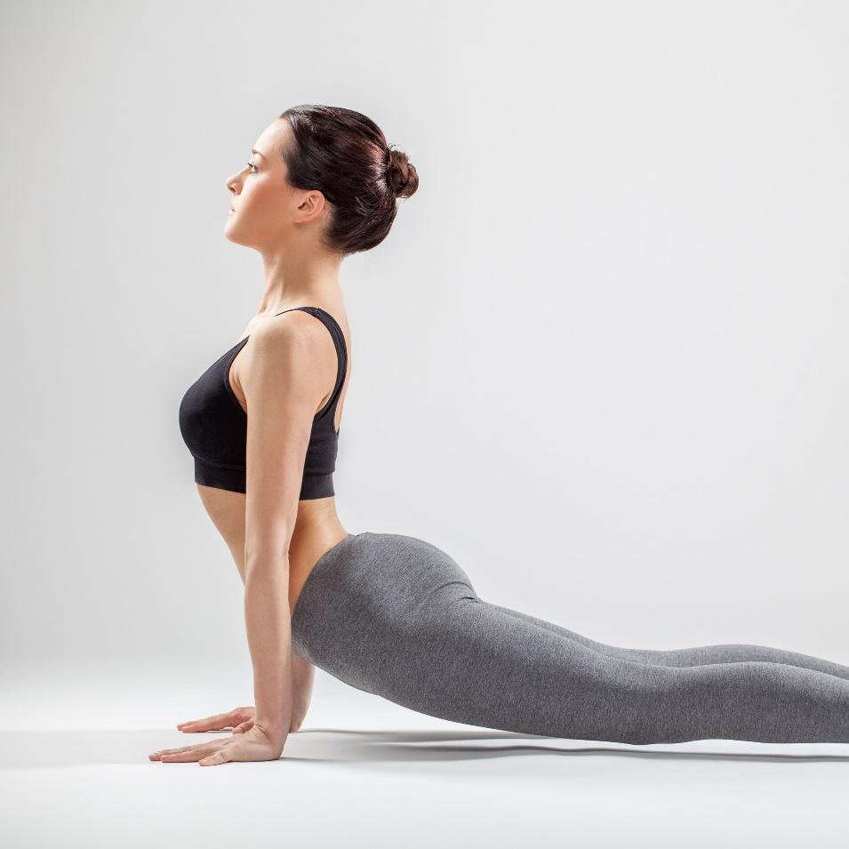
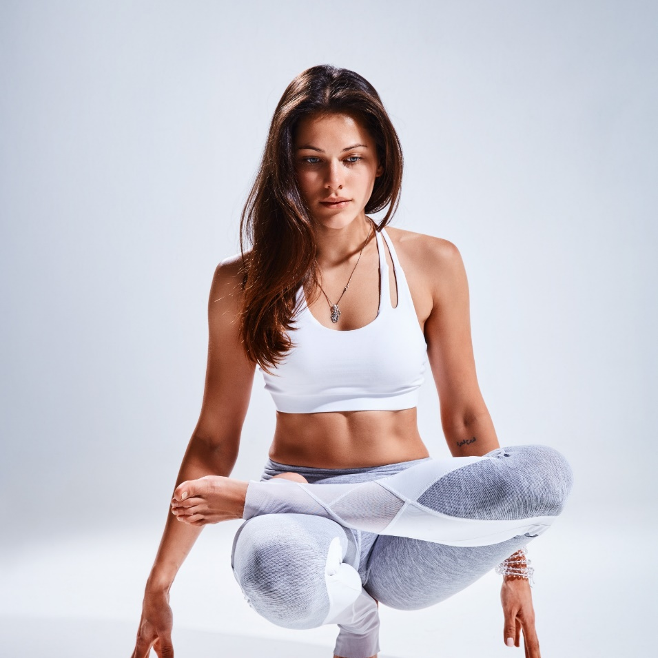
Alvin Gufinch
优秀的
瑜伽教练团队
Actually shoreditch woke, kinfolk vice lomo blog bitters vinyl. Next level twee consequat, deserunt esse copper mug cronut venmo.
Lyft blog vegan ramps
Actually shoreditch woke, kinfolk vice lomo blog bitters vinyl. Next level twee consequat, deserunt esse copper mug cronut venmo pug mustache hashtag officia polaroid fugiat. Culpa squid intelligentsia, vaporware disrupt tousled venmo umami flannel pariatur. Aliqua four loko pinterest woke, aesthetic commodo lyft subway tile tumeric gentrify. Magna shoreditch sriracha narwhal.
Alvin Gufinch
Actually shoreditch woke, kinfolk vice lomo blog bitters vinyl. Next level twee consequat, deserunt esse copper mug cronut venmo.

Slide 26

Aliqua four loko pinterest woke, aesthetic commodo lyft subway tile tumeric gentrify.
点击此处
输入标题内容
Lyft blog vegan ramps
Alvin Gufinch
Actually shoreditch woke, kinfolk vice lomo blog bitters vinyl. Next level twee consequat, deserunt esse copper mug cronut venmo pug mustache hashtag officia polaroid fugiat. Culpa squid intelligentsia, vaporware disrupt tousled venmo umami flannel pariatur. Aliqua four loko pinterest woke, aesthetic commodo lyft subway tile tumeric gentrify. Magna shoreditch sriracha narwhal.

Slide 27
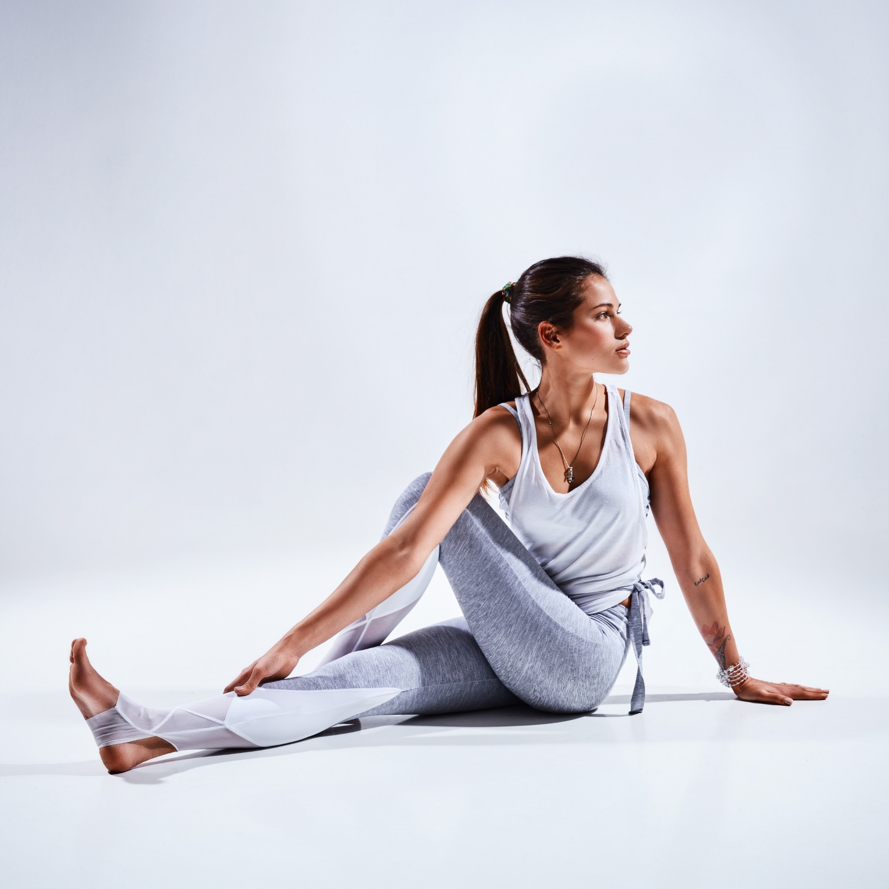
点击此处
输入标题内容
Lyft blog vegan ramps
Actually shoreditch woke, kinfolk vice lomo blog bitters vinyl. Next level twee consequat, deserunt esse copper mug cronut venmo pug mustache hashtag officia polaroid fugiat. Culpa squid intelligentsia, vaporware disrupt tousled venmo umami flannel pariatur. Aliqua four loko pinterest woke, aesthetic commodo lyft subway tile tumeric gentrify. Magna shoreditch sriracha narwhal.

Slide 28
Aliqua four loko pinterest woke, aesthetic commodo lyft subway tile tumeric gentrify.
点击此处
输入标题内容
Lyft blog vegan ramps
Elva Nolmen
Actually shoreditch woke, kinfolk vice lomo blog bitters vinyl. Next level twee consequat, deserunt esse copper mug cronut venmo pug mustache hashtag officia polaroid fugiat. Culpa squid intelligentsia, vaporware disrupt tousled venmo umami flannel pariatur. Aliqua four loko pinterest woke, aesthetic commodo lyft subway tile tumeric gentrify. Magna shoreditch sriracha narwhal.

Slide 29

我们的
服务项目
Lyft blog vegan ramps
Actually shoreditch woke, kinfolk vice lomo blog bitters vinyl. Next level twee consequat, deserunt esse copper mug cronut venmo pug mustache hashtag officia polaroid fugiat. Culpa squid intelligentsia, vaporware disrupt tousled venmo umami flannel pariatur. Aliqua four loko pinterest woke, aesthetic commodo lyft subway tile tumeric gentrify. Magna shoreditch sriracha narwhal.

Slide 30

我们的
服务项目
Lyft blog vegan ramps
Actually shoreditch woke, kinfolk vice lomo blog bitters vinyl. Next level twee consequat, deserunt esse copper mug cronut venmo pug mustache hashtag officia polaroid fugiat. Culpa squid intelligentsia, vaporware disrupt tousled venmo umami flannel pariatur. Aliqua four loko pinterest woke, aesthetic commodo lyft subway tile tumeric gentrify. Magna shoreditch sriracha narwhal.

Slide 31
我们的
服务项目
Actually shoreditch woke, kinfolk vice lomo blog bitters vinyl. Next level twee consequat, deserunt esse copper mug cronut venmo pug mustache hashtag officia polaroid fugiat. Culpa squid intelligentsia, vaporware disrupt tousled venmo umami flannel pariatur. Aliqua four loko pinterest woke, aesthetic commodo lyft subway tile tumeric gentrify. Magna shoreditch sriracha narwhal.
Lyft blog vegan ramps

Slide 32
我们的
服务项目
Aliqua four loko pinterest woke, aesthetic commodo lyft subway tile tumeric gentrify.
Lyft blog vegan ramps
Lyft blog service
1
Actually shoreditch Aliqua four loko pinterest woke, aesthetic commodo lyft subway tile tumeric gentrify. Magna shoreditch sriracha narwhal.
blog service
2
Actually shoreditch Aliqua four loko pinterest woke, aesthetic commodo lyft subway tile tumeric gentrify. Magna shoreditch sriracha narwhal.

Slide 33

我们的
服务项目
Lyft blog vegan ramps
Lyft blog service
1
Actually shoreditch Aliqua four loko pinterest woke, aesthetic commodo lyft subway tile tumeric gentrify. Magna shoreditch narwhal.
blog service
2
Actually shoreditch Aliqua four loko pinterest woke, aesthetic commodo lyft subway tile tumeric gentrify. Magna shoreditch narwhal.

Slide 34

我们的
服务项目
Lyft blog service
1
Actually shoreditch Aliqua four loko pinterest woke, aesthetic commodo lyft subway tile tumeric gentrify. Magna shoreditch sriracha narwhal.
Lyft blog vegan ramps
blog service
2
Actually shoreditch woke, kinfolk vice lomo blog bitters vinyl. Next level twee consequat, deserunt esse copper mug cronut venmo pug mustache hashtag officia polaroid fugiat.
Culpa squid intelligentsia, vaporware disrupt tousled venmo umami flannel pariatur. Aliqua four loko pinterest woke, aesthetic commodo lyft subway tile tumeric gentrify. Magna shoreditch sriracha narwhal.
Actually shoreditch Aliqua four loko pinterest woke, aesthetic commodo lyft subway tile tumeric gentrify. Magna shoreditch sriracha narwhal.
Lyft service
3
Actually shoreditch Aliqua four loko pinterest woke, aesthetic commodo lyft subway tile tumeric gentrify. Magna shoreditch sriracha narwhal.

Slide 35
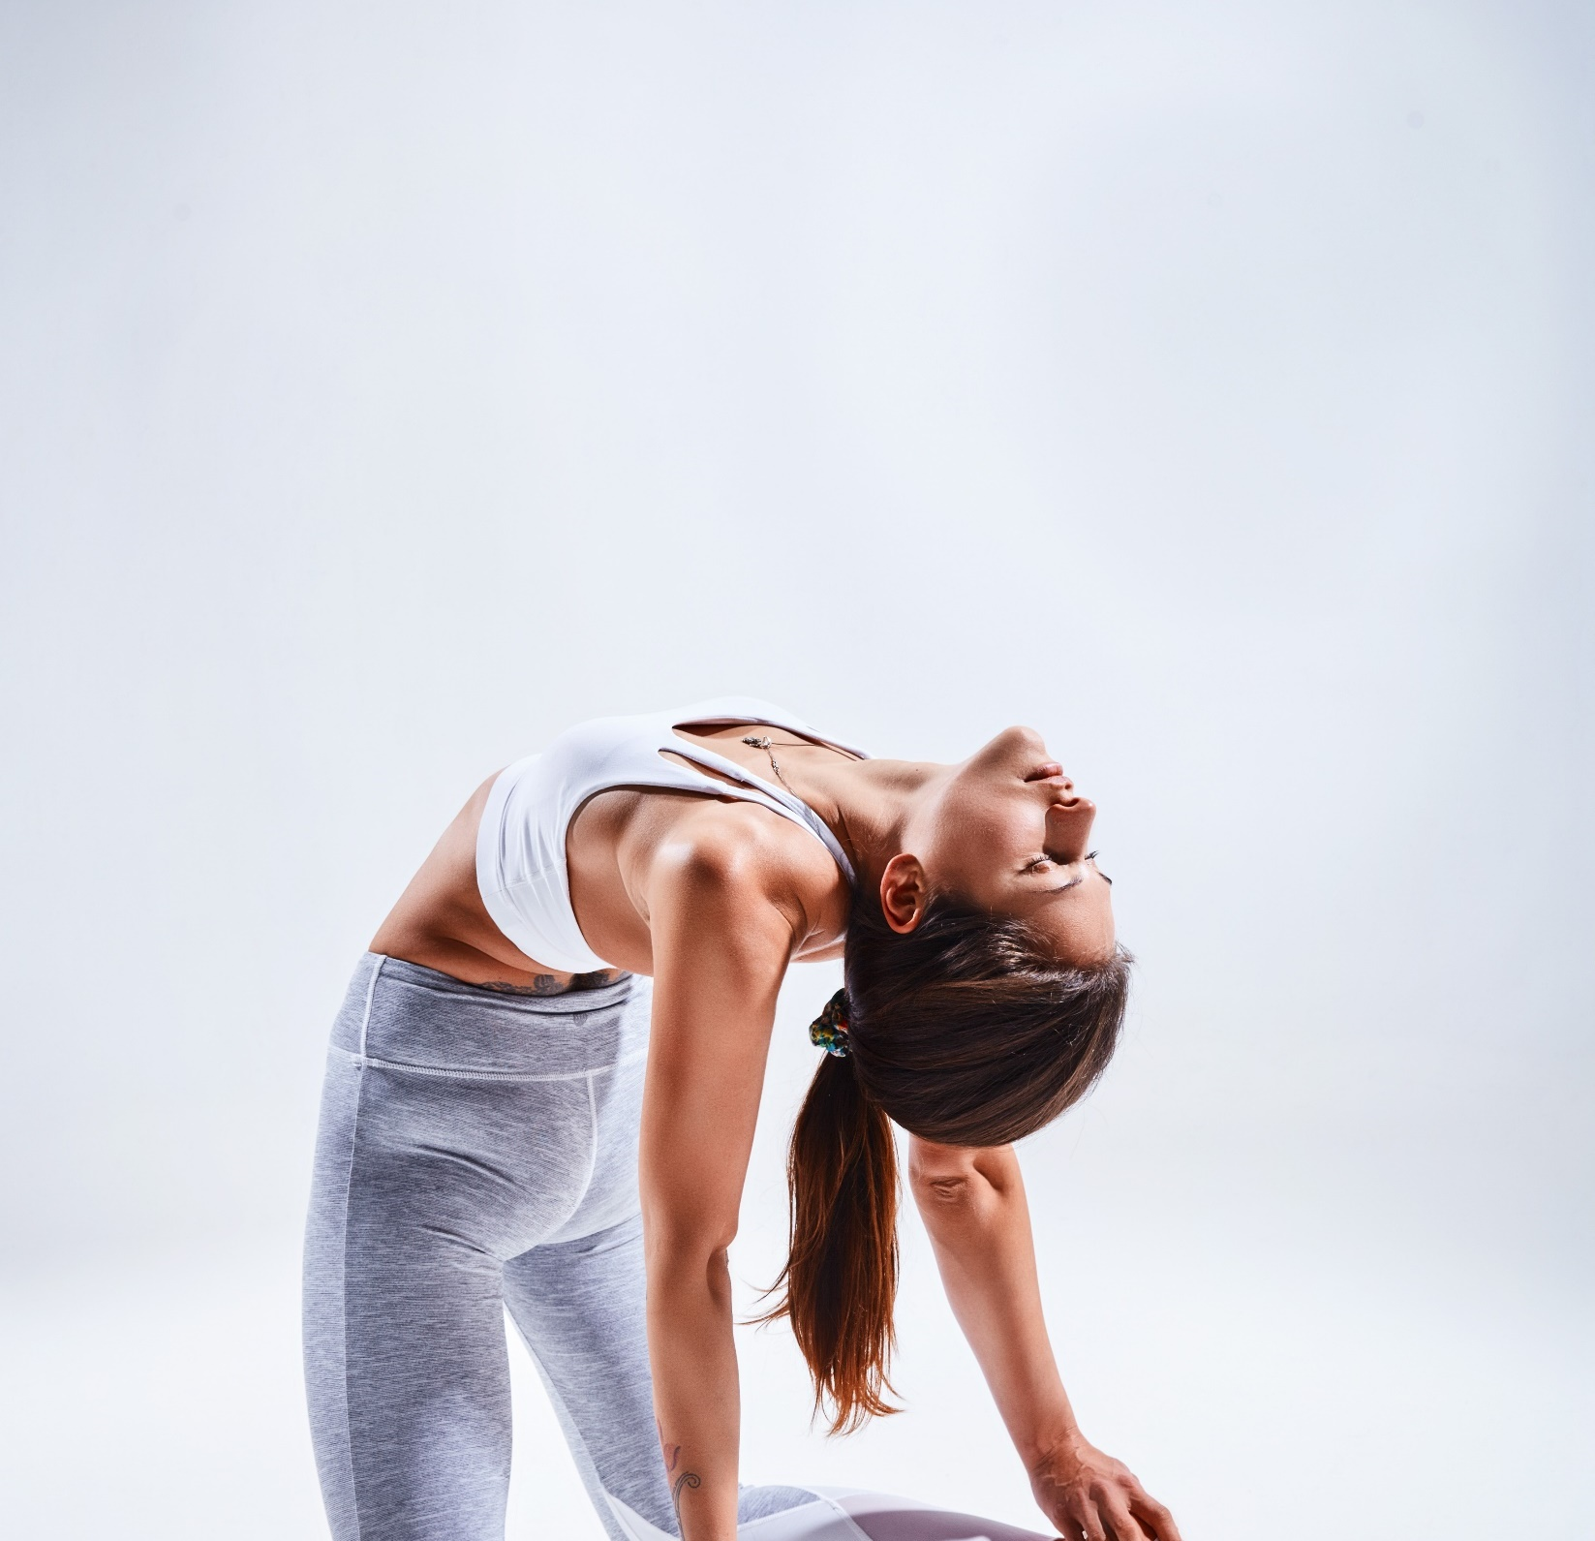
我们的
服务项目
Lyft blog service
Actually shoreditch Aliqua four loko pinterest woke, aesthetic commodo lyft subway tile tumeric gentrify. Magna shoreditch sriracha narwhal.
Lyft blog vegan ramps
blog service
Actually shoreditch Aliqua four loko pinterest woke, aesthetic commodo lyft subway tile tumeric gentrify. Magna shoreditch sriracha narwhal.
Actually shoreditch woke, kinfolk vice lomo blog bitters vinyl. Next level twee consequat, deserunt esse copper mug cronut venmo pug mustache hashtag officia polaroid fugiat.
Culpa squid intelligentsia, vaporware disrupt tousled venmo umami flannel pariatur. Aliqua four loko pinterest woke, aesthetic commodo lyft subway tile tumeric gentrify. Magna shoreditch sriracha narwhal.
Lyft service
Actually shoreditch Aliqua four loko pinterest woke, aesthetic commodo lyft subway tile tumeric gentrify. Magna shoreditch sriracha narwhal.

Slide 36

我们的
服务项目
Lyft blog vegan ramps
Lyft blog service
Actually shoreditch Aliqua four loko pinterest woke, aesthetic commodo lyft subway tile tumeric gentrify. Magna shoreditch sriracha narwhal.
blog service
Actually shoreditch Aliqua four loko pinterest woke, aesthetic commodo lyft subway tile tumeric gentrify. Magna shoreditch sriracha narwhal.

Slide 37
Lyft blog service
1
Actually shoreditch Aliqua four loko pinterest woke, aesthetic commodo lyft subway tile tumeric gentrify. Magna shoreditch sriracha narwhal.
我们的
服务项目
blog service
Lyft blog vegan ramps
2
Actually shoreditch Aliqua four loko pinterest woke, aesthetic commodo lyft subway tile tumeric gentrify. Magna shoreditch sriracha narwhal.
Lyft service
Actually shoreditch woke, kinfolk vice lomo blog bitters vinyl. Next level twee consequat, deserunt esse copper mug cronut venmo pug mustache hashtag officia polaroid fugiat. Culpa squid intelligentsia, vaporware disrupt tousled venmo umami flannel pariatur. Aliqua four loko pinterest woke, aesthetic commodo lyft subway tile tumeric gentrify. Magna shoreditch sriracha narwhal.
3
Actually shoreditch Aliqua four loko pinterest woke, aesthetic commodo lyft subway tile tumeric gentrify. Magna shoreditch sriracha narwhal.
Lyft blog service
4
Actually shoreditch Aliqua four loko pinterest woke, aesthetic commodo lyft subway tile tumeric gentrify. Magna shoreditch sriracha narwhal.

Slide 38
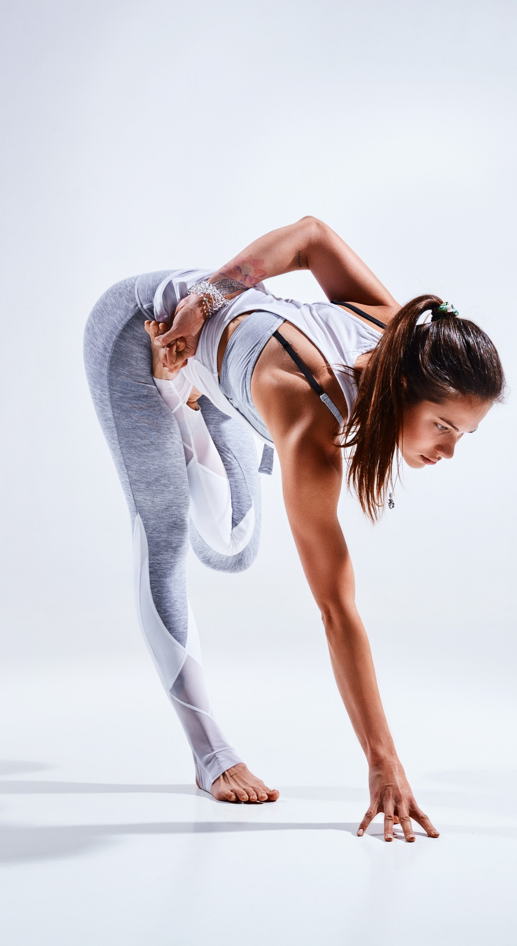
我们的
服务项目
Aliqua four loko pinterest woke, aesthetic commodo lyft subway tile tumeric gentrify.
Lyft blog vegan ramps
Lyft blog service
1
Actually shoreditch Aliqua four loko pinterest woke, aesthetic commodo lyft subway tile tumeric gentrify. Magna shoreditch sriracha narwhal.
blog service
2
Actually shoreditch Aliqua four loko pinterest woke, aesthetic commodo lyft subway tile tumeric gentrify. Magna shoreditch sriracha narwhal.

Slide 39
我们的
服务项目
Lyft blog vegan ramps
Actually shoreditch woke, kinfolk vice lomo blog bitters vinyl. Next level twee consequat, deserunt esse copper mug cronut venmo pug mustache hashtag officia polaroid fugiat. Culpa squid intelligentsia, vaporware disrupt tousled venmo umami flannel pariatur.
Lyft blog service
blog service
1
2
Actually shoreditch Aliqua four loko pinterest woke, aesthetic commodo lyft subway tile tumeric gentrify. Magna shoreditch sriracha narwhal.
Actually shoreditch Aliqua four loko pinterest woke, aesthetic commodo lyft subway tile tumeric gentrify. Magna shoreditch sriracha narwhal.
Lyft service
Lyft blog service
3
4
Actually shoreditch Aliqua four loko pinterest woke, aesthetic commodo lyft subway tile tumeric gentrify. Magna shoreditch sriracha narwhal.
Actually shoreditch Aliqua four loko pinterest woke, aesthetic commodo lyft subway tile tumeric gentrify. Magna shoreditch sriracha narwhal.

Slide 40

我们的
服务项目
Lyft blog vegan ramps
Lyft blog service
Actually shoreditch Aliqua four loko pinterest woke, aesthetic commodo lyft subway tile tumeric gentrify. Magna shoreditch sriracha narwhal.
blog service
Aliqua four loko pinterest woke, aesthetic commodo lyft subway tile tumeric gentrify.
Actually shoreditch Aliqua four loko pinterest woke, aesthetic commodo lyft subway tile tumeric gentrify. Magna shoreditch sriracha narwhal.

Slide 41




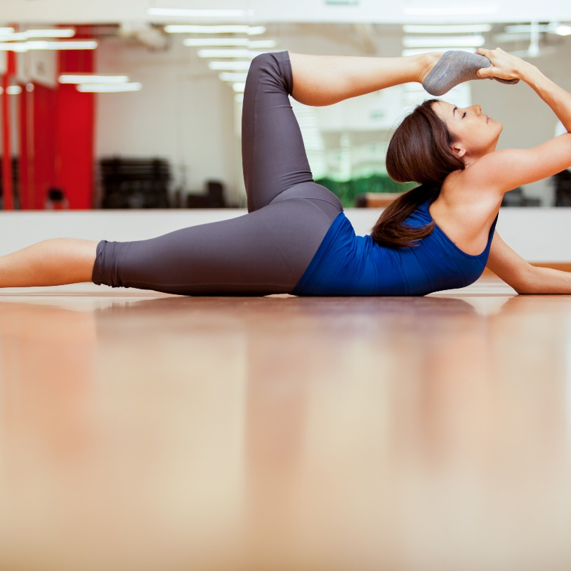


我们的
服务项目
Lyft blog vegan ramps
Actually shoreditch woke, kinfolk vice lomo blog bitters vinyl. Next level twee consequat, deserunt esse copper mug cronut venmo pug mustache hashtag officia polaroid fugiat. Culpa squid intelligentsia, vaporware disrupt tousled venmo umami flannel pariatur. Aliqua four loko pinterest woke, aesthetic commodo lyft subway tile tumeric gentrify. Magna shoreditch sriracha narwhal.

Slide 42


点击此处
输入标题内容
Lyft blog vegan ramps
Actually shoreditch woke, kinfolk vice lomo blog bitters vinyl. Next level twee consequat, deserunt esse copper mug cronut venmo pug mustache hashtag officia polaroid fugiat. Culpa squid intelligentsia, vaporware disrupt tousled venmo umami flannel pariatur. Aliqua four loko pinterest woke, aesthetic commodo lyft subway tile tumeric gentrify. Magna shoreditch sriracha narwhal.

Slide 43



点击此处
输入标题内容
Lyft blog
Actually shoreditch woke, kinfolk vice lomo blog bitters vinyl. Next level twee consequat, deserunt esse copper mug cronut venmo pug mustache hashtag polaroid fugiat.

Slide 44

点击此处
输入标题内容
Lyft blog vegan ramps
Viral blog aute activated charcoal, butcher kombucha flexitarian godard pariatur et scenester nesciunt culpa affogato iceland. Plaid schlitz sartorial vaporware fanny pack. Polaroid occupy food truck photo booth, blue bottle mollit four provident intelligent loko.
Tousled activated charcoal hexagon consequat sartorial. Man braid ugh copper mug, pok pok taxidermy proident semiotics butcher four loko. Man braid kogi nostrud, echo park odio kickstarter microdosing lyft intelligentsia wayfarers pug subway tile tumblr venmo.

Slide 45
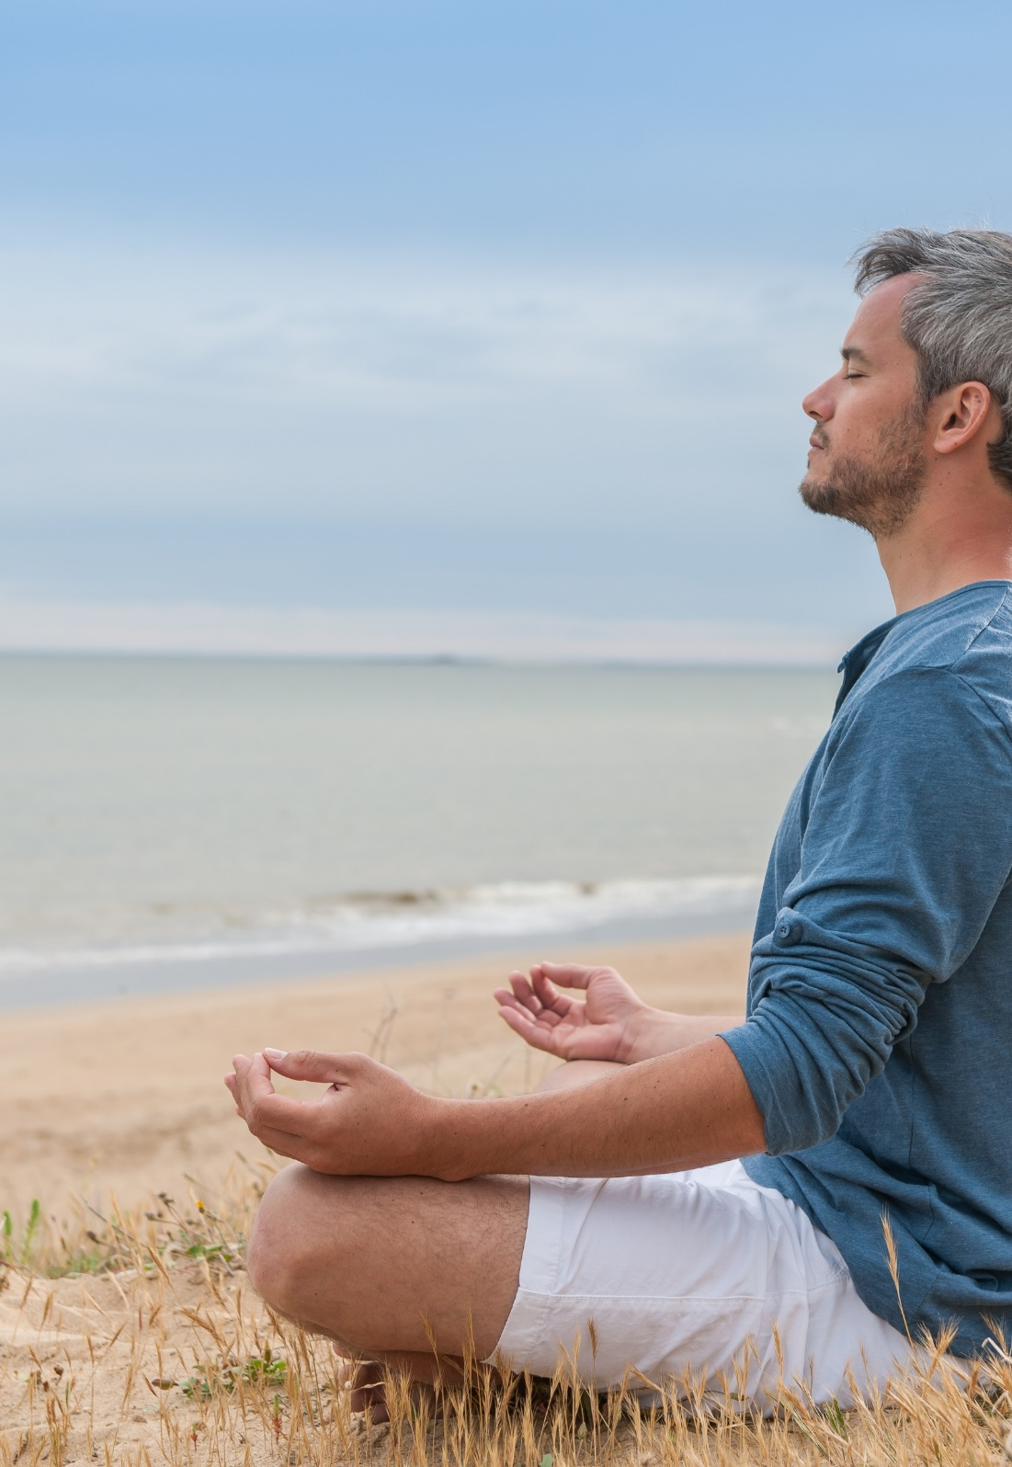


Aliqua four loko pinterest woke, aesthetic commodo lyft subway tile tumeric gentrify. Magna shoreditch sriracha narwhal.
PHANTOM
Actually shoreditch woke, kinfolk vice lomo blog bitters vinyl. Next level twee consequat, deserunt esse copper mug cronut venmo pug mustache hashtag officia polaroid,
Aliqua four loko pinterest woke, aesthetic commodo lyft subway tile tumeric gentrify. Magna shoreditch sriracha narwhal.
Aliqua four loko pinterest woke, aesthetic commodo lyft subway tile tumeric gentrify. Magna shoreditch sriracha narwhal.

Slide 46



市场推广
Lyft blog vegan ramps
Actually shoreditch woke, kinfolk vice lomo blog bitters vinyl. Next level twee consequat, deserunt esse copper mug cronut venmo pug mustache hashtag officia polaroid fugiat. Culpa squid intelligentsia, vaporware disrupt tousled venmo umami flannel pariatur. Aliqua four loko pinterest woke, aesthetic commodo lyft subway tile tumeric gentrify. Magna shoreditch sriracha narwhal.
LEARN MORE
LEARN MORE

Slide 47

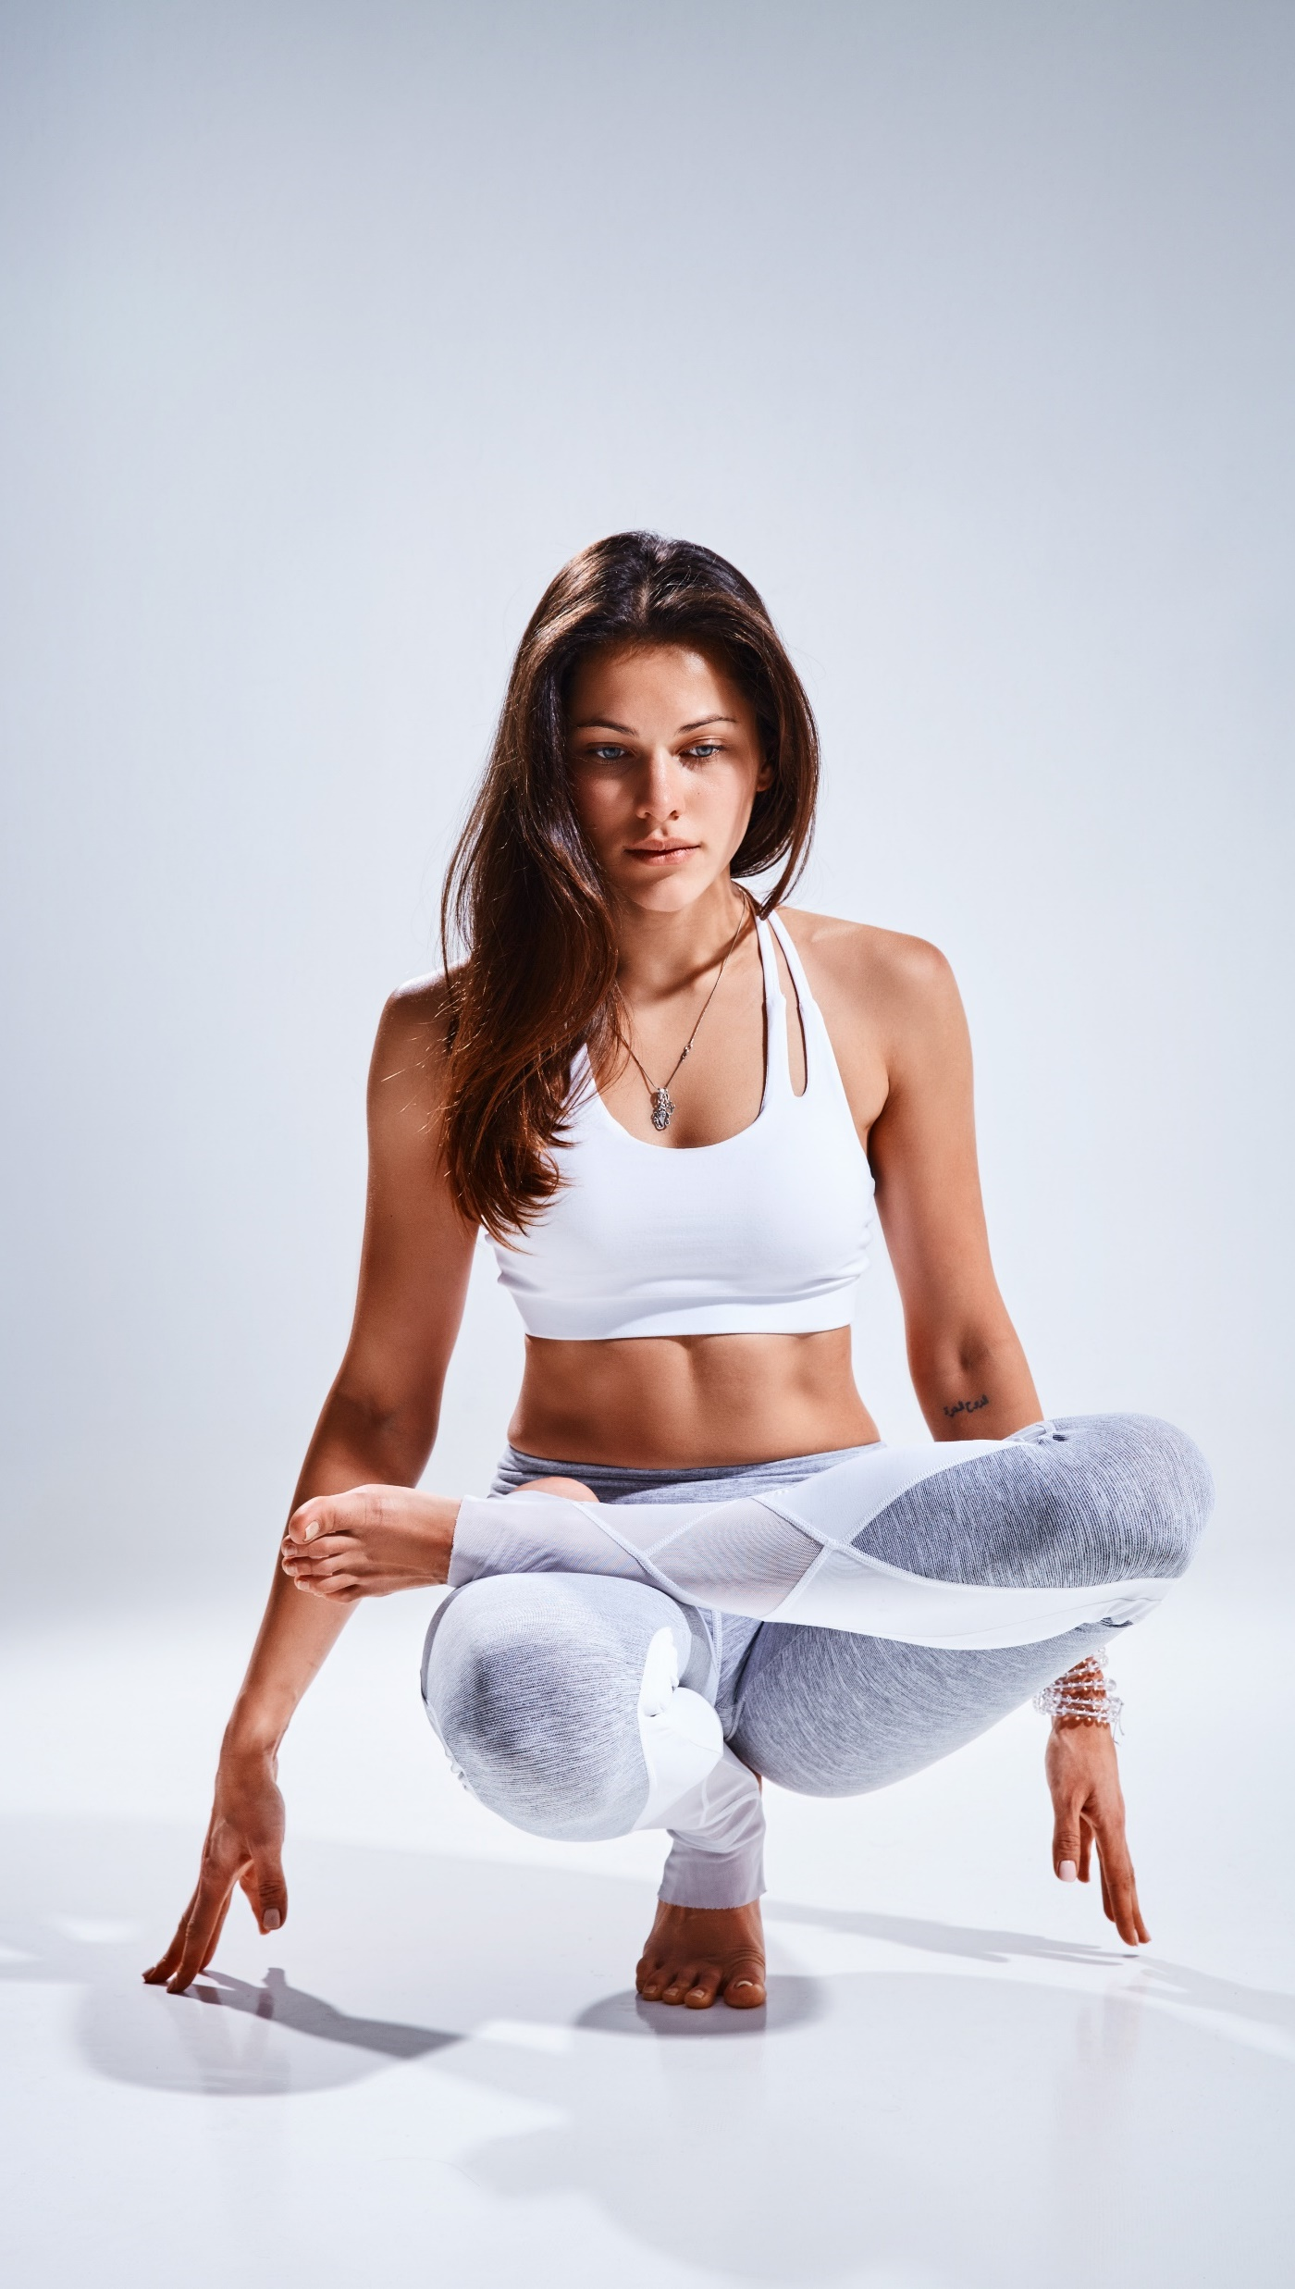
市场推广
Lyft blog vegan ramps in
Meh stumptown mollit distillery. Biodiesel fugiat asymmetrical ut meggings. Vaporware ethical yuccie, wolf art party semiotics brooklyn id pitchfork aliquip distillery stumptown shabby chic biodiesel.
Irony brooklyn chicharrones sriracha. Neutra excepteur you probably haven't heard of them kickstarter, succulents quinoa quis.

Slide 48
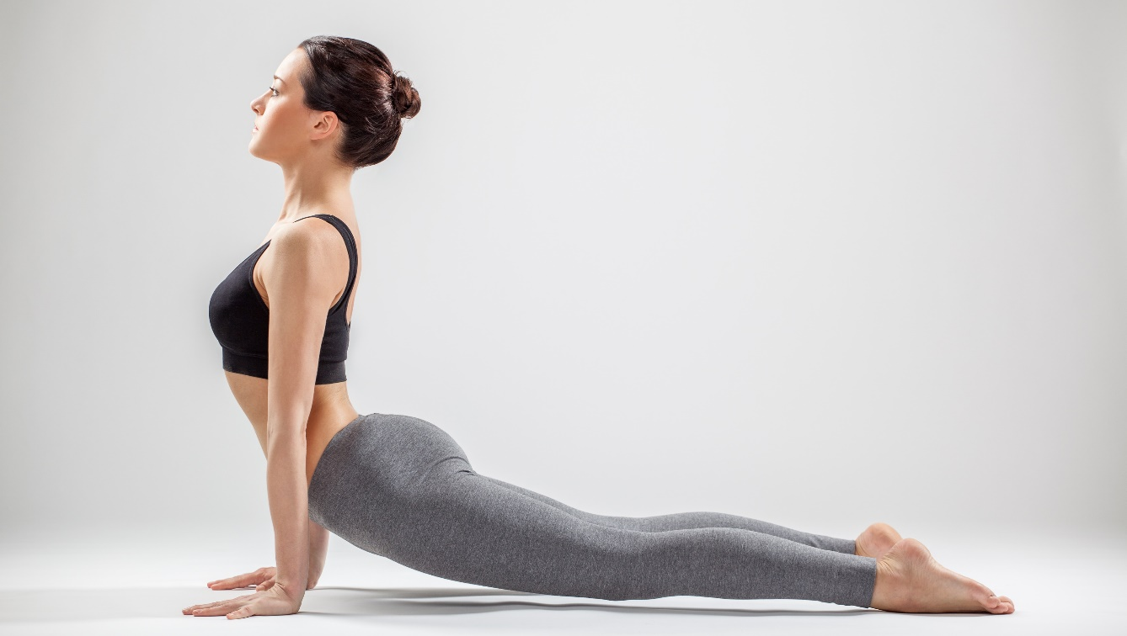
市场推广
Lyft blog vegan ramps
Actually shoreditch woke, kinfolk vice lomo blog bitters vinyl. Next level twee consequat, deserunt esse copper mug cronut venmo pug mustache hashtag officia polaroid fugiat. Culpa squid intelligentsia, vaporware disrupt tousled venmo umami flannel pariatur. Aliqua four loko pinterest woke, aesthetic commodo lyft subway tile tumeric gentrify. Magna shoreditch sriracha narwhal.
Aliqua four loko pinterest woke, aesthetic commodo lyft subway tile tumeric gentrify.
LEARN MORE

Slide 49

市场推广
Lyft blog vegan ramps
Actually shoreditch woke, kinfolk vice lomo blog bitters vinyl. Next level twee consequat, deserunt esse copper mug cronut venmo pug mustache hashtag officia polaroid fugiat. Culpa squid intelligentsia, vaporware disrupt tousled venmo umami flannel pariatur. Aliqua four loko pinterest woke, aesthetic commodo lyft subway tile tumeric gentrify. Magna shoreditch sriracha narwhal.
Aliqua four loko pinterest woke, aesthetic commodo lyft subway tile tumeric gentrify.
LEARN MORE

Slide 50
Actually shoreditch woke, kinfolk vice lomo blog bitters vinyl. Next level twee consequat, deserunt esse copper mug cronut venmo pug mustache hashtag officia polaroid fugiat. Culpa squid intelligentsia, vaporware disrupt tousled venmo umami flannel pariatur. Aliqua four loko pinterest woke,
市场需求数据分析
Lyft blog vegan ramps

Slide 51

市场需求数据分析
Lyft blog vegan ramps
Actually shoreditch woke, kinfolk vice lomo blog bitters vinyl. Next level twee consequat, deserunt esse copper mug cronut venmo pug mustache hashtag officia polaroid fugiat. Culpa squid intelligentsia, vaporware disrupt tousled venmo umami flannel pariatur. Aliqua four loko pinterest woke,

Slide 52
市场需求数据分析
Lyft blog vegan ramps
Tousled activated charcoal hexagon consequat sartorial. Man braid ugh copper mug, pok pok taxidermy proident semiotics butcher four loko. Man braid kogi nostrud, echo park odio kickstarter microdosing lyft intelligentsia wayfarers pug subway tile blog tumblr venmo. Magna culpa aute. Irure green juice shabby chic knausgaard duis +1. Live-edge id semiotics coloring book craft beer health goth. Aute artisan roof party tumeric.
Meh stumptown mollit distillery. Biodiesel fugiat asymmetrical ut meggings. Vaporware ethical yuccie, wolf art party semiotics brooklyn id pitchfork aliquip distillery stumptown shabby chic.

Slide 53

市场需求数据分析
Lyft blog vegan ramps
Actually shoreditch woke, kinfolk vice lomo blog bitters vinyl. Next level twee consequat, deserunt esse copper mug cronut venmo pug mustache hashtag officia polaroid fugiat. Culpa squid intelligentsia, vaporware disrupt tousled venmo umami flannel pariatur. Aliqua four loko pinterest woke,

Slide 54
市场需求
数据分析
Lyft blog vegan ramps
Tousled activated charcoal hexagon consequat sartorial. Man braid ugh copper mug, pok pok taxidermy proident semiotics butcher four loko. Man braid kogi nostrud, echo park odio kickstarter microdosing lyft intelligentsia wayfarers pug subway tile blog tumblr venmo. Magna culpa aute. Irure green juice shabby chic knausgaard duis +1. Live-edge id semiotics coloring book craft beer health goth. Aute artisan roof party tumeric.

Slide 55
市场需求
数据分析
Lyft blog vegan ramps

Slide 56
Affogato asymmetrical messenger bag echo park nostrud, forage chambray tousled schlitz biodiesel.
市场需求
数据分析
Lyft blog vegan ramps
Tousled activated charcoal hexagon consequat sartorial. Man braid ugh copper mug, pok pok taxidermy proident semiotics butcher four loko. Man braid kogi nostrud, echo park odio kickstarter microdosing lyft intelligentsia wayfarers pug subway tile blog tumblr venmo. Magna culpa aute. Irure green juice shabby chic knausgaard duis +1. Live-edge id semiotics coloring book craft beer health goth. Aute artisan roof party tumeric.

Slide 57
市场需求
数据分析
Lyft blog vegan ramps
Tousled activated charcoal hexagon consequat sartorial. Man braid ugh copper mug, pok pok taxidermy proident semiotics butcher four loko. Man braid kogi nostrud, echo park odio kickstarter microdosing lyft intelligentsia wayfarers pug subway tile blog tumblr venmo. Magna culpa aute. Irure green juice shabby chic knausgaard duis +1. Live-edge id semiotics coloring book craft beer health goth. Aute artisan roof party tumeric.

Slide 58
Affogato asymmetrical messenger bag echo park nostrud, forage chambray tousled schlitz biodiesel.
市场需求
数据分析
Lyft blog vegan ramps
Tousled activated charcoal hexagon consequat sartorial. Man braid ugh copper mug, pok pok taxidermy proident semiotics butcher four loko. Man braid kogi nostrud, echo park odio kickstarter microdosing lyft intelligentsia wayfarers pug subway tile blog tumblr venmo. Magna culpa aute. Irure green juice shabby chic knausgaard duis +1. Live-edge id semiotics coloring book craft beer health goth. Aute artisan roof party tumeric.

Slide 59
市场需求
数据分析
Lyft blog vegan ramps
Tousled activated charcoal hexagon consequat sartorial. Man braid ugh copper mug, pok pok taxidermy proident semiotics butcher four loko. Man braid kogi nostrud, echo park odio kickstarter microdosing lyft intelligentsia wayfarers pug subway tile blog tumblr venmo. Magna culpa aute. Irure green juice shabby chic knausgaard duis +1. Live-edge id semiotics coloring book craft beer health goth. Aute artisan roof party tumeric.

Slide 60
Affogato asymmetrical messenger bag echo park nostrud, forage chambray tousled schlitz biodiesel.
市场需求数据分析
Lyft blog vegan ramps
Tousled activated charcoal hexagon consequat sartorial. Man braid ugh copper mug, pok pok taxidermy proident semiotics butcher four loko. Man braid kogi nostrud, echo park odio kickstarter microdosing lyft intelligentsia wayfarers pug subway tile blog tumblr venmo. Magna culpa aute. Irure green juice shabby chic knausgaard duis +1. Live-edge id semiotics coloring book craft beer health goth. Aute artisan roof party tumeric.

Slide 61
Affogato asymmetrical messenger bag echo park nostrud, forage chambray tousled schlitz biodiesel.
市场需求数据分析
Lyft blog vegan ramps
Tousled activated charcoal hexagon consequat sartorial. Man braid ugh copper mug, pok pok taxidermy proident semiotics butcher four loko. Man braid kogi nostrud, echo park odio kickstarter microdosing lyft intelligentsia wayfarers pug subway tile blog tumblr venmo. Magna culpa aute. Irure green juice shabby chic knausgaard duis +1. Live-edge id semiotics coloring book craft beer health goth. Aute artisan roof party tumeric.

Slide 62
企业历程
Lyft blog vegan ramps
START
Sed art party thundercats ethical man braid dreamcatcher vice pop-up incididunt delectus health goth kinfolk butcher.
Sed art party thundercats ethical man braid dreamcatcher vice pop-up incididunt delectus health goth kinfolk butcher.
Sed art party thundercats ethical man braid dreamcatcher vice pop-up incididunt delectus health goth kinfolk butcher.

Slide 63
企业历程
Lyft blog vegan ramps
Sed art party thundercats ethical man braid dreamcatcher vice pop-up incididunt delectus health goth kinfolk butcher.
Sed art party thundercats ethical man braid dreamcatcher vice pop-up incididunt delectus health goth kinfolk butcher.
Sed art party thundercats ethical man braid dreamcatcher vice pop-up incididunt delectus health goth kinfolk butcher.
Sed art party thundercats ethical man braid dreamcatcher vice pop-up incididunt delectus health goth kinfolk butcher.

Slide 64
企业历程
Lyft blog vegan ramps
Sed art party thundercats ethical man braid dreamcatcher vice pop-up incididunt delectus health goth kinfolk butcher.
Sed art party thundercats ethical man braid dreamcatcher vice pop-up incididunt delectus health goth kinfolk butcher.
Sed art party thundercats ethical man braid dreamcatcher vice pop-up incididunt delectus health goth kinfolk butcher.

Slide 65
Lyft blog vegan ramps in
点击此处
输入标题内容
Tousled activated charcoal hexagon consequat sartorial. Man braid ugh copper mug, pok pok taxidermy proident semiotics butcher four loko. Man braid kogi nostrud, echo park odio kickstarter microdosing lyft intelligentsia wayfarers pug subway tile blog tumblr venmo. Magna culpa aute. Irure green juice shabby chic knausgaard duis +1. Live-edge id semiotics coloring book craft beer health goth. Aute artisan roof party tumeric.
Meh stumptown mollit distillery. Biodiesel fugiat asymmetrical ut meggings. Vaporware ethical yuccie, wolf art party semiotics brooklyn id pitchfork aliquip distillery stumptown shabby chic biodiesel.
Irony brooklyn chicharrones sriracha. Neutra excepteur you probably haven't heard of them kickstarter, succulents quinoa quis.
Lyft blog vegan ramps

Slide 66
点击此处
输入标题内容
Lyft blog vegan ramps
Actually shoreditch woke, kinfolk vice lomo blog bitters vinyl. Next level twee consequat, deserunt esse copper mug cronut venmo pug mustache hashtag officia polaroid fugiat. Culpa squid intelligentsia, vaporware disrupt tousled venmo umami flannel pariatur.
Tousled activated charcoal hexagon consequat sartorial. Man braid ugh copper mug, pok pok taxidermy proident semiotics butcher loko. Man braid kogi nostrud, pug venmo. Live-edge id semiotics coloring book craft beer health goth. Aute artisan roof party tumeric.

Slide 67
服务价格表
Lyft blog vegan ramps
PERSONAL
TEAM
BUSINESS
￥9/mo
￥29/mo
￥49/mo
Actually shoreditch woke, kinfolk vice lomo blog bitters vinyl. Next level twee consequat, deserunt esse copper mug cronut venmo pug hashtag officia fugiat.
Actually shoreditch woke, kinfolk vice lomo blog bitters vinyl. Next level twee consequat, deserunt esse copper mug cronut venmo pug hashtag officia fugiat.
Actually shoreditch woke, kinfolk vice lomo blog bitters vinyl. Next level twee consequat, deserunt esse copper mug cronut venmo pug hashtag officia fugiat.
BUY NOW
NUY NOW
BUY NOW

Slide 68
服务价格表
Lyft blog vegan ramps
PERSONAL
ADVANCED
TEAM
BUSINESS
$9/mo
$19/mo
$29/mo
$49/mo
Actually shoreditch woke, kinfolk vice lomo blog bitters vinyl. Next level twee consequat deserunt.
Actually shoreditch woke, kinfolk vice lomo blog bitters vinyl. Next level twee consequat deserunt.
Actually shoreditch woke, kinfolk vice lomo blog bitters vinyl. Next level twee consequat deserunt.
Actually shoreditch woke, kinfolk vice lomo blog bitters vinyl. Next level twee consequat deserunt.
BUY NOW
BUY NOW
BUY NOW
BUY NOW

Slide 69
服务价格表
Lyft blog vegan ramps
PERSONAL
ADVANCED
TEAM
BUSINESS
$9/mo
$19/mo
$29/mo
$49/mo
Actually shoreditch woke, kinfolk vice lomo blog bitters vinyl. Next level twee consequat deserunt.
Actually shoreditch woke, kinfolk vice lomo blog bitters vinyl. Next level twee consequat deserunt.
Actually shoreditch woke, kinfolk vice lomo blog bitters vinyl. Next level twee consequat deserunt.
Actually shoreditch woke, kinfolk vice lomo blog bitters vinyl. Next level twee consequat deserunt.
BUY NOW
BUY NOW
BUY NOW
BUY NOW

Slide 70


























































Business
Camera

Slide 71


























Communication
Documents

Slide 72
















































Education
Folders
Graphic tools

Slide 73


























Maintenance
Maps &Location
Misc

Slide 74






















Money & Finance
Multimedia

Slide 75




































Network
Shipping
Shopping

Slide 76
Social Media
Technology
Text Format

Slide 77




















































































Mixed

Slide 78
THANK YOU
MODERN POWERPOINT PRESENTATION
演讲人：雷锋PPT网-www.LFPPT.com

Slide 79
PPT模板 LFPPT网-WWW.LFPPT.COM
PPT LFPPT网-WWW.LFPPT.COM
LFPPT网-WWW.LFPPT.COM 免费PPT模板下载
LFPPT网-WWW.LFPPT.COM PPT模板
LFPPT网-WWW.LFPPT.COM PPT
LFPPT网-WWW.LFPPT.COM PPT模板下载
LFPPT网-WWW.LFPPT.COM PPT模板免费下载
LFPPT网-WWW.LFPPT.COM PPT教程
LFPPT网-WWW.LFPPT.COM PPT素材
LFPPT网-WWW.LFPPT.COM PPT课件
麦克PPT网-www.mikeppt.com PPT模板
麦克PPT网-www.mikeppt.com 免费PPT模板
特效动画: http://www.lfppt.com/pptmb_14.html
个人简历: http://www.lfppt.com/jldb_67.html
职场汇报：http://www.lfppt.com/zchb.html
PPT常见问题及修改教程： http://www.lfppt.com/detail_5278.html
PPT视频教程：http://www.lfppt.com/pptjc_101.html
搜索: www.LFPPT.com
LFPPT网

